Slide 1
Summary of the various screens with comments
UI Mockups

Slide 2

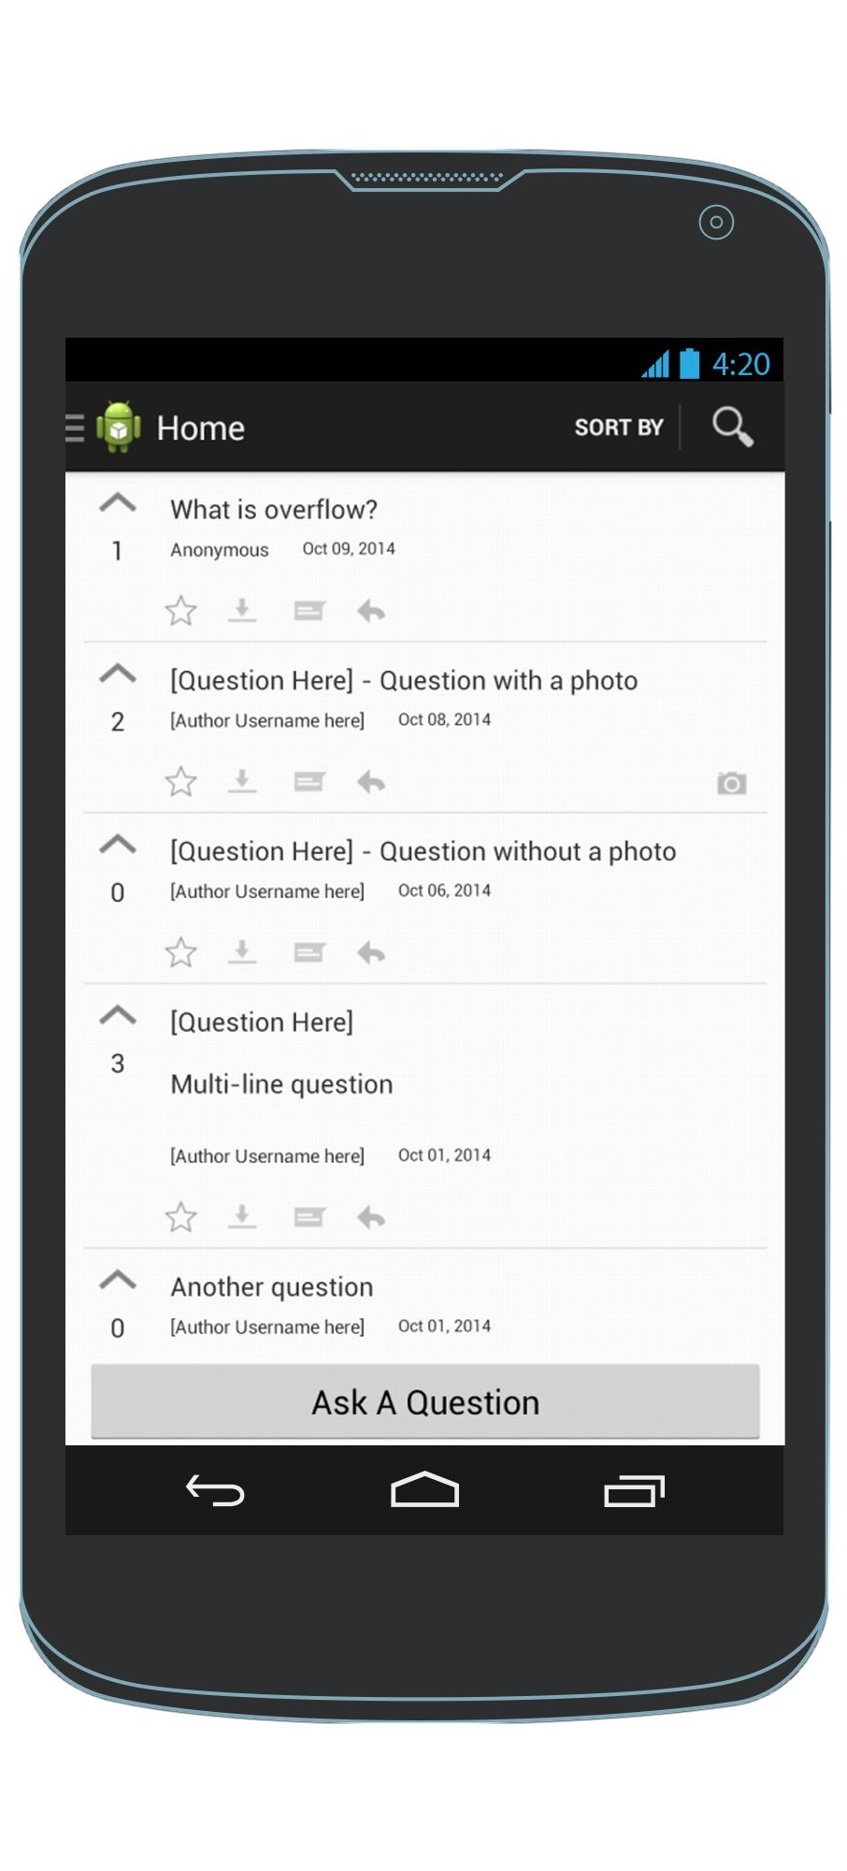





Upvote
Favorite
Scroll to browse questions
Mark as offline
Answer
Reply
HomeScreen
Picture Present Indicator

Slide 3
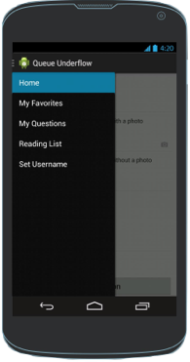
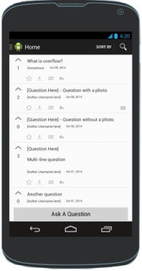
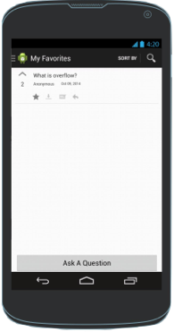
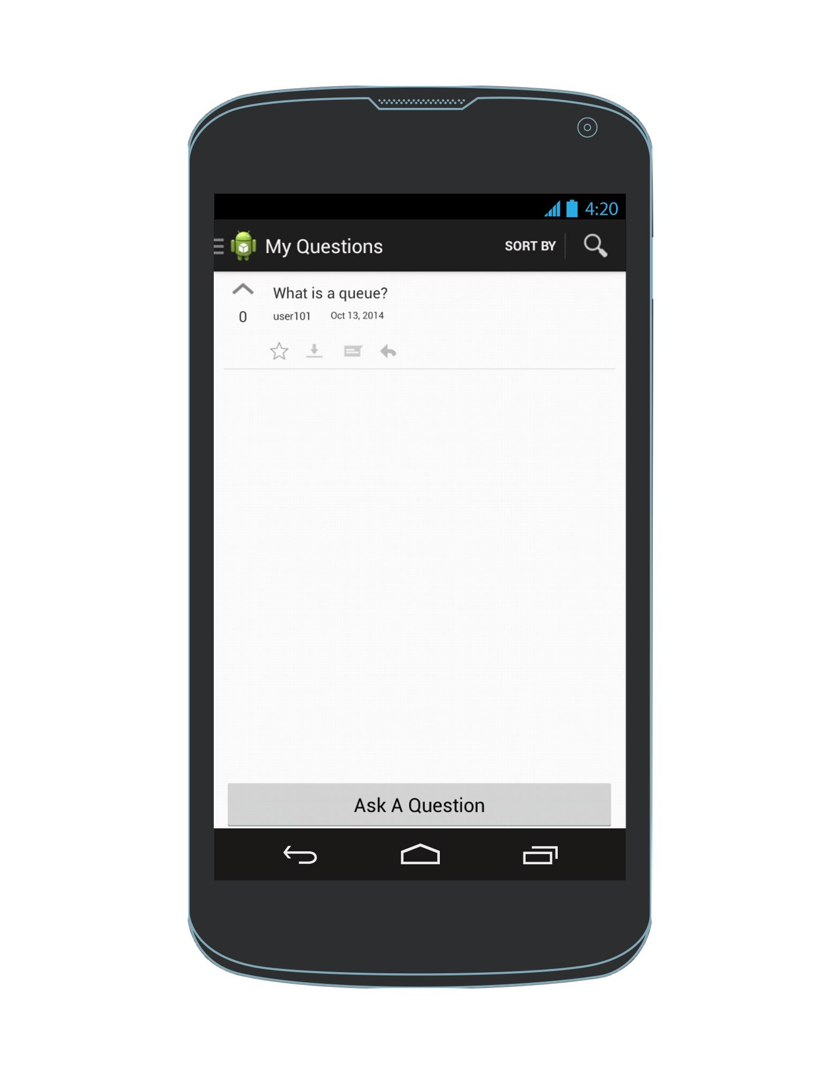
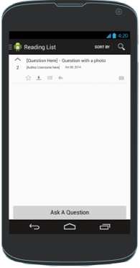
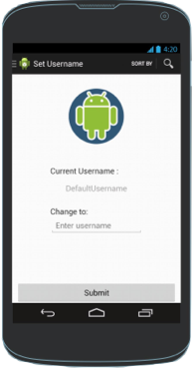
Screens reachable directly from the navigation drawer
Navigation Drawer
HomeScreen
My Favorites
Note: So far, the navigation drawer is accessible from any view except AskAQuestion & AddAnAnswer screens which are separate activities while all screens reachable directly from the navigation drawer are fragments
My Questions
Offline Q & As
Set Username

Slide 4
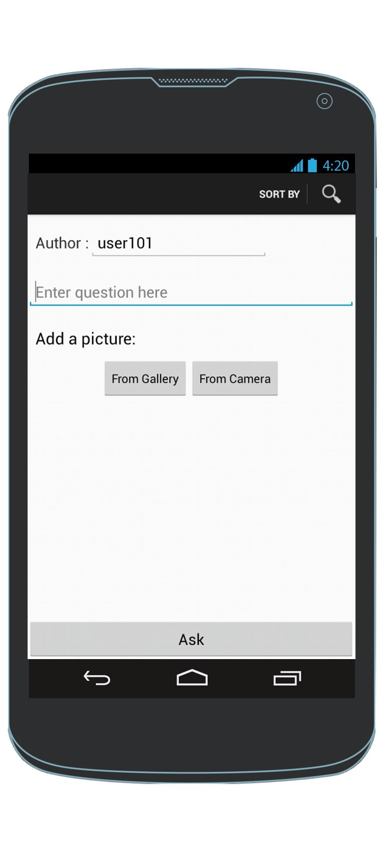
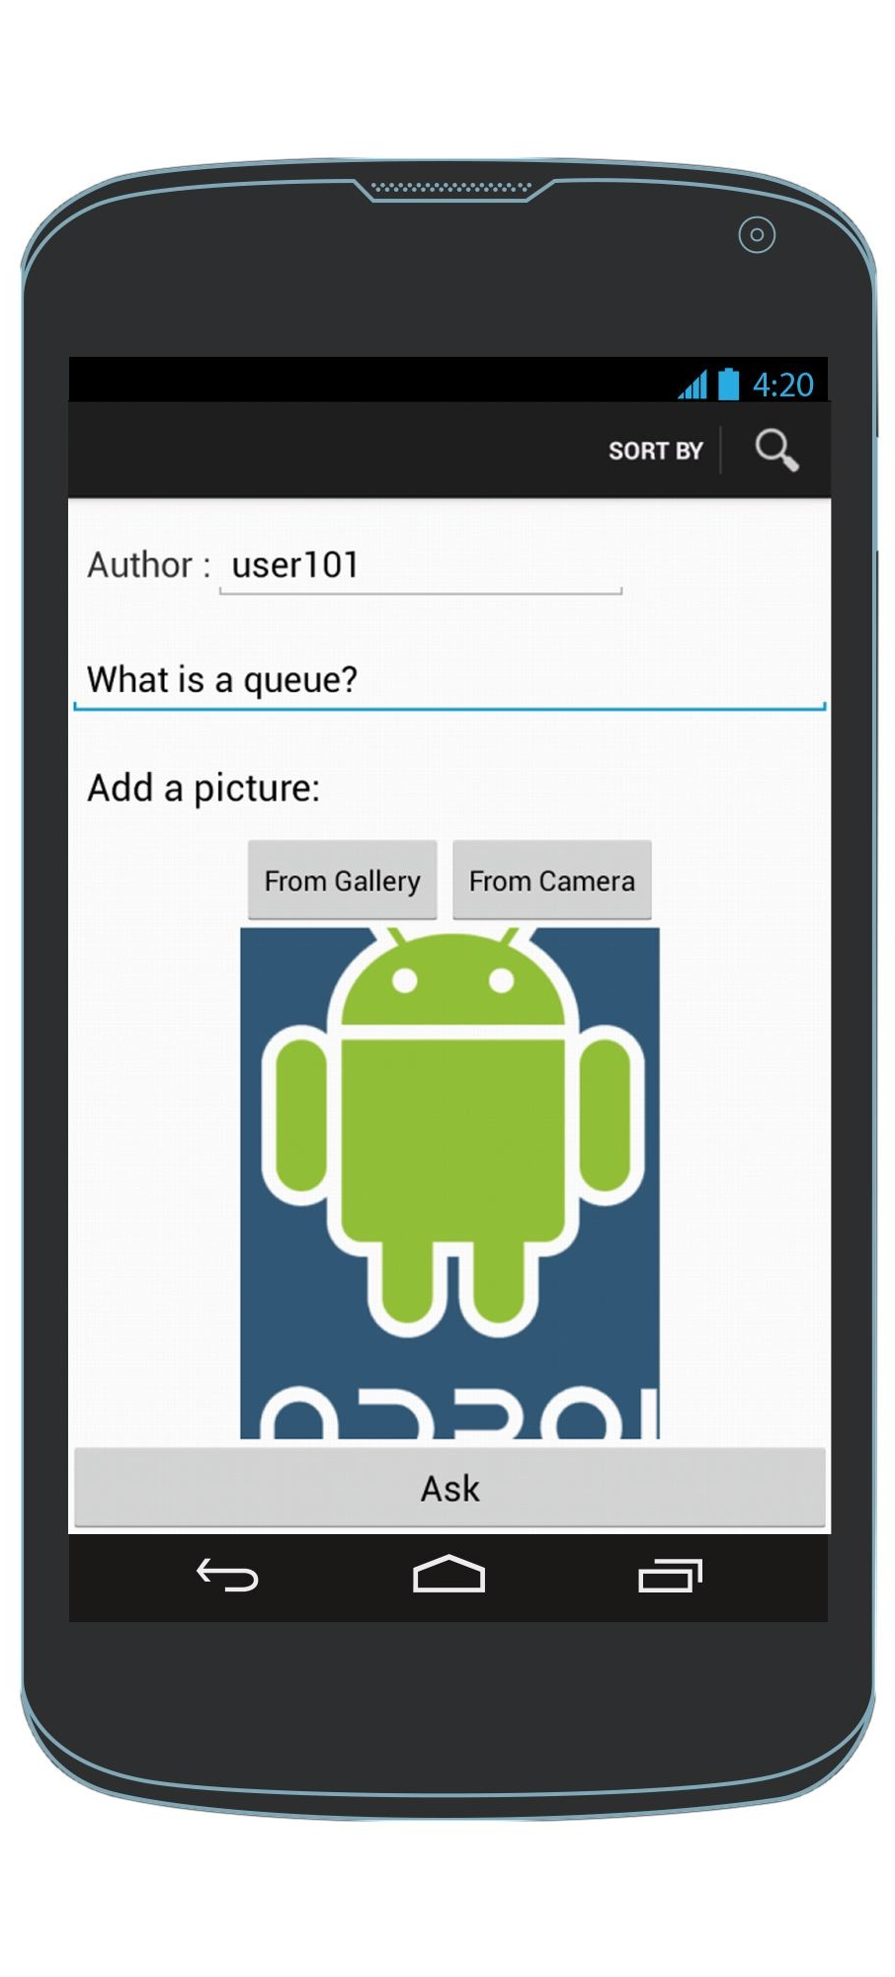
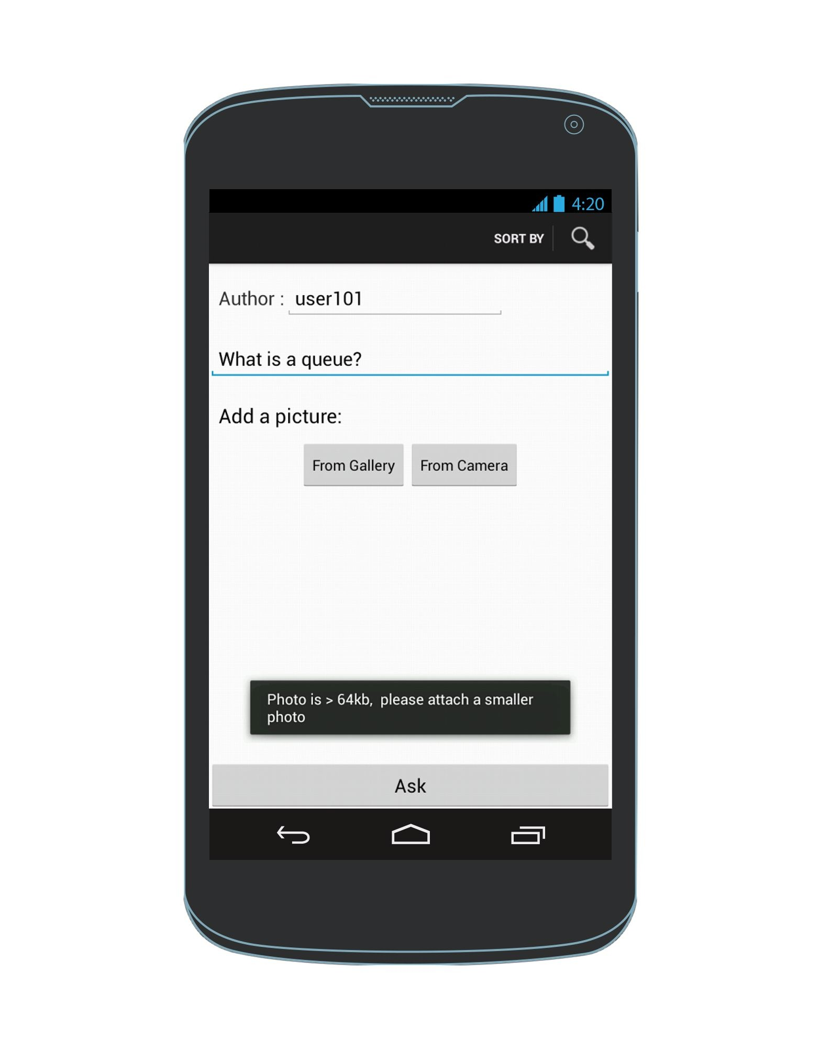
Variants of AskAQuestion Screen
By default, Author edit text box shows the set username But the user can change it directly here also.
Default
Successfully attached photo
Failed attempt to attach a photo
Note: Analogous for variants of AddAnAnswer Screen

Slide 5
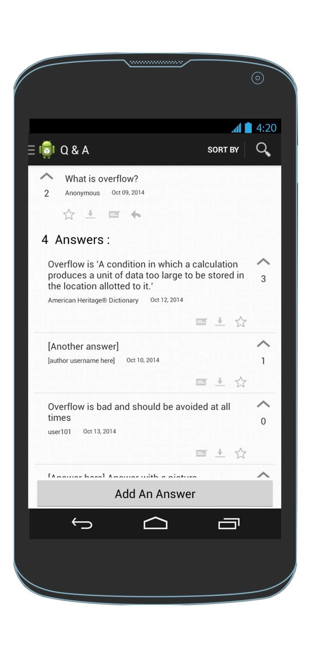
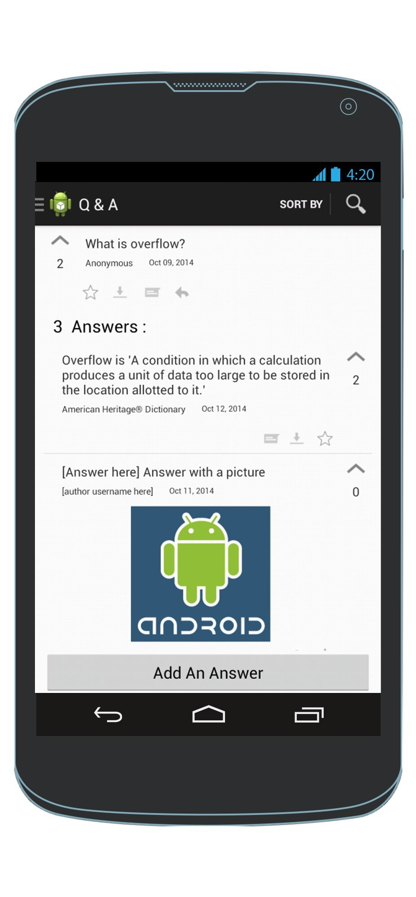
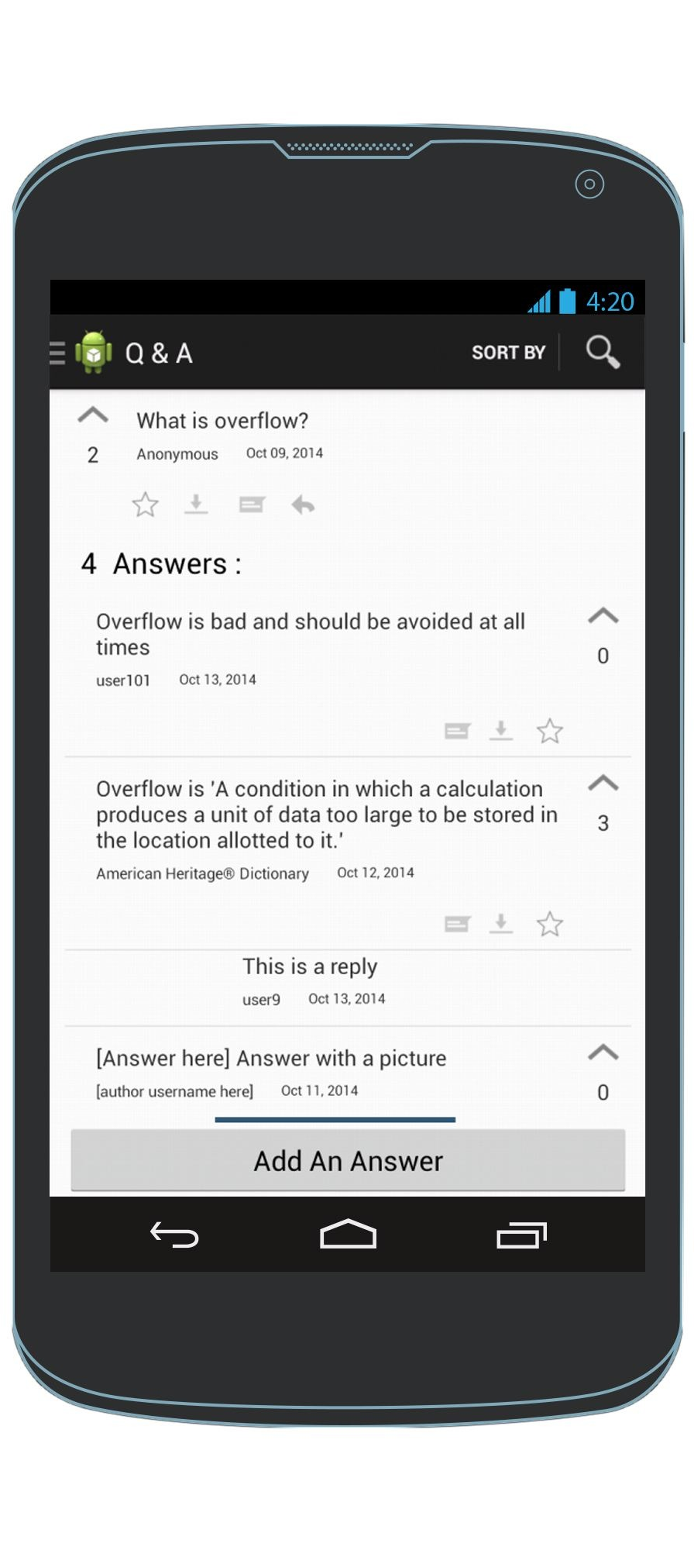
Variants of Q & A Screen
Some answers may not have a photo
Some answers may have a photo
Show replies of an answer
Note: Q & A screen is reachable from any screen showing question, by clicking on the question
Note: Default view is to show answers without the replies.
Note: User clicks on an answer to see the replies of that answer
Note: Inflate a different list_item_answer xml file for each answer in the list adapter depending on whether the answer has a photo or not, indicated by the photo indicator.

Slide 6
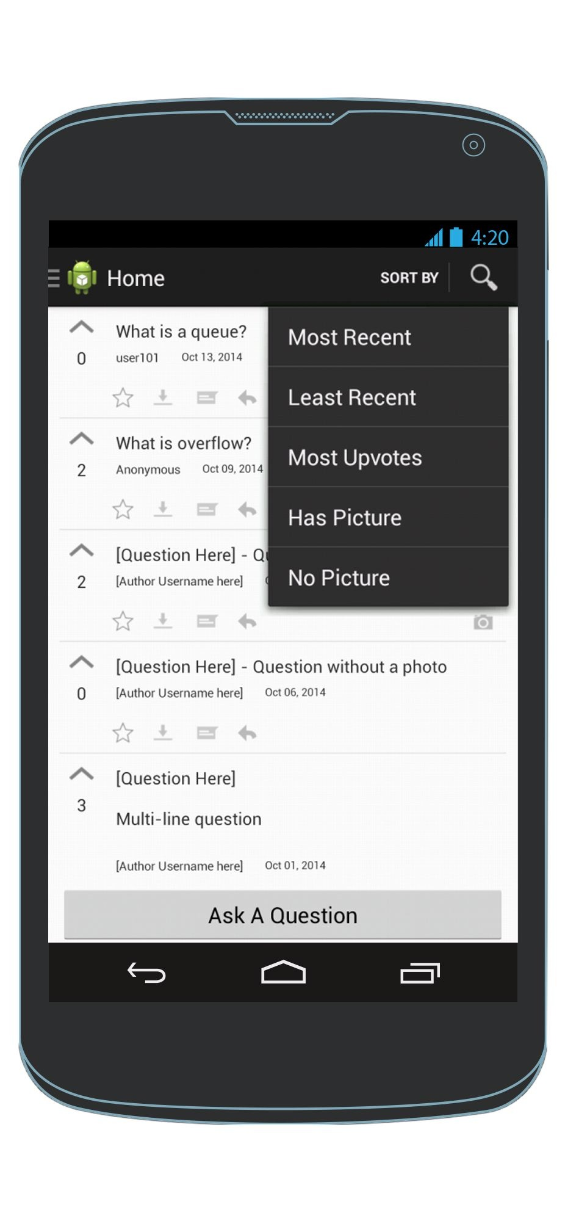
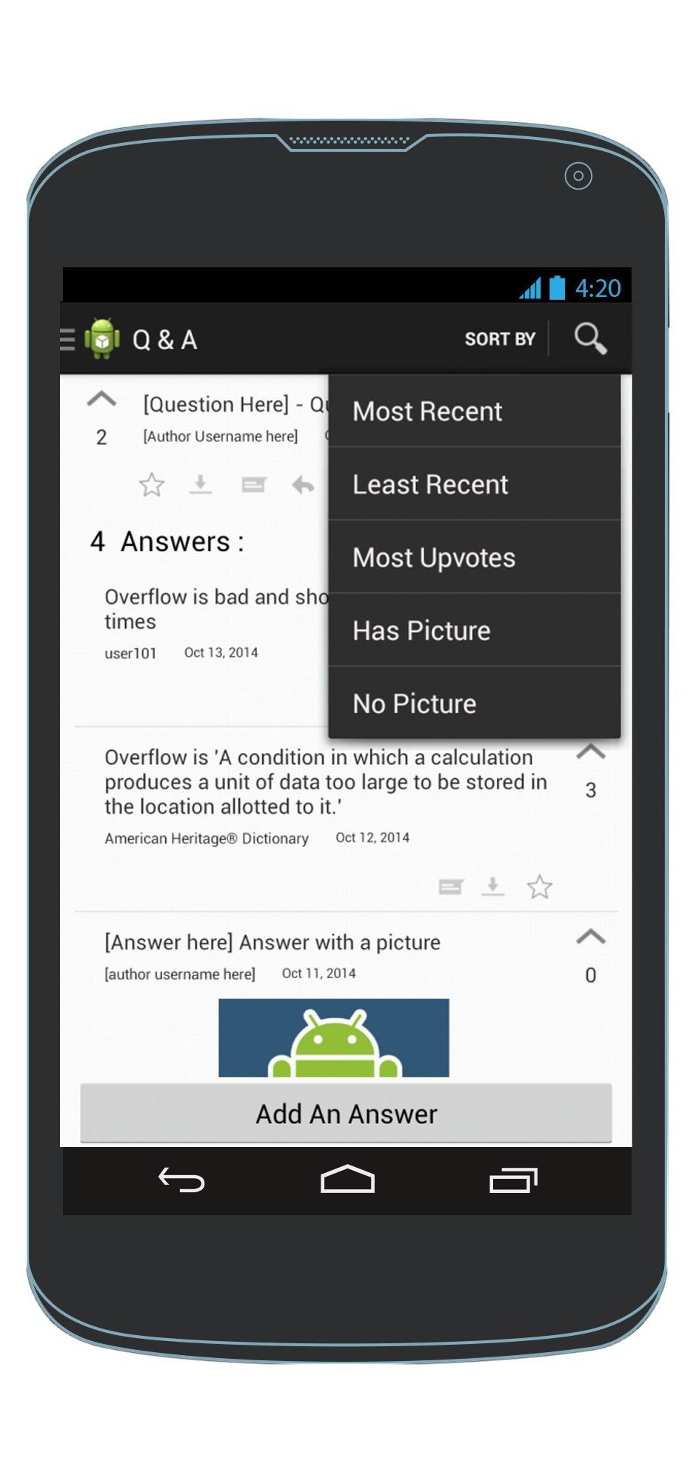
Sorting Question & Answers
Can sort questions
Can sort answers
HomeScreen
Q & A View
Note : Only sorts answers by criteria selected if on the Q & A Screen
Note : Else the “SortBy” menu selector sorts the questions

Slide 7
Question & Answer List Item Layout
Question
Answer
Questions have an answer button (Action)
Answers do not have an answer button (Action)
Upvote is on the LEFT
side for Questions
Upvote is on the RIGHT
side for Answers
Photo indicator
Note :A question with a photo is displayed by default when in Q & A Screen Note : But a photo corresponding to a question is not displayed by default on any other screen.
Note : To view the photo corresponding to a question, the user must click on the question to go to the Q & A screen.
An answer with a photo is displayed by default when in Q & A Screen
Reference: Picture preview android photo taken from http://www.busywait.org/storage/news/images/QaxtYWPHjw.png

Slide 8
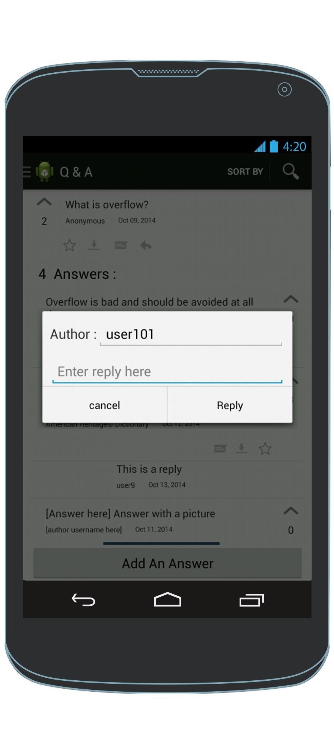
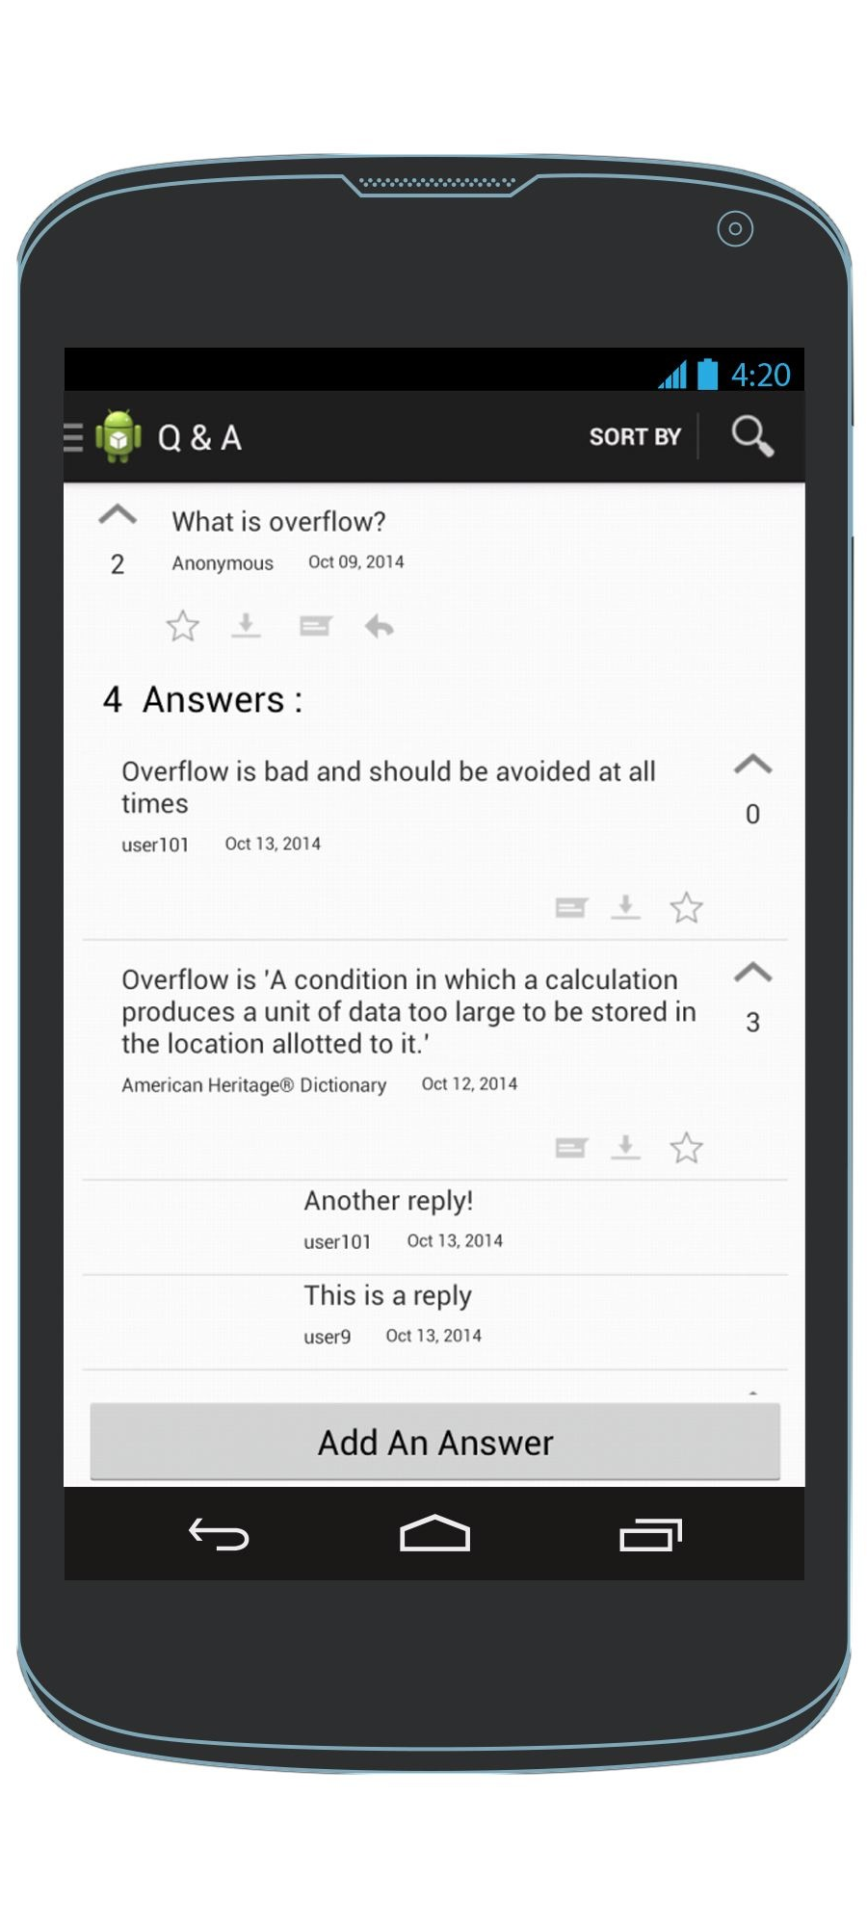
Adding & Viewing Replies
A dialog is used to make/add a reply.

Slide 9
Storyboard

Slide 10

Accessing the navigation drawer
Click this
OR
Swipe from the left edge towards the right
Any Screen
Navigation Drawer

Slide 11
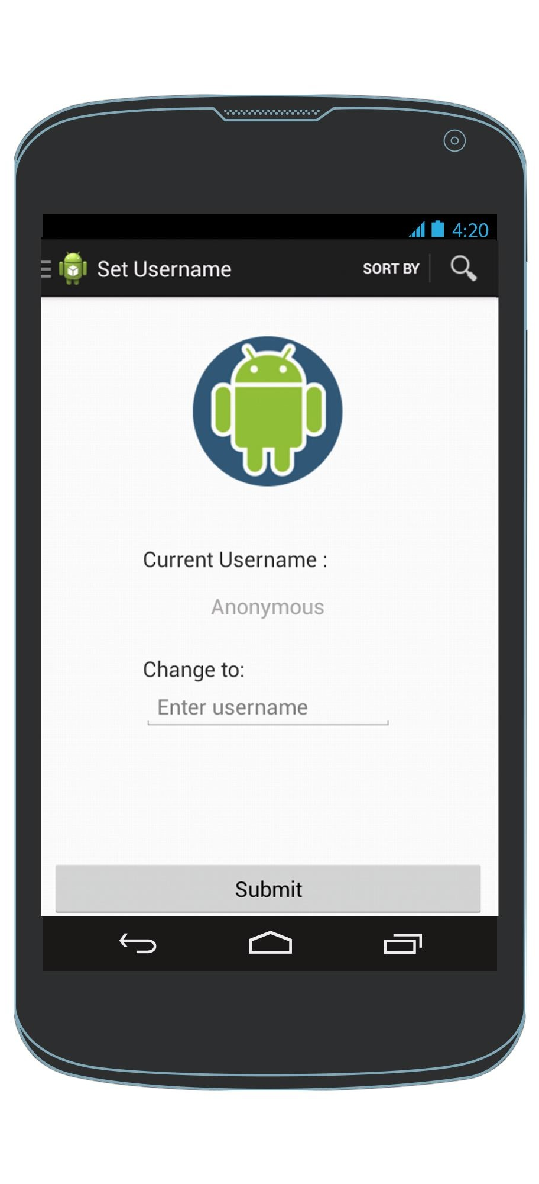
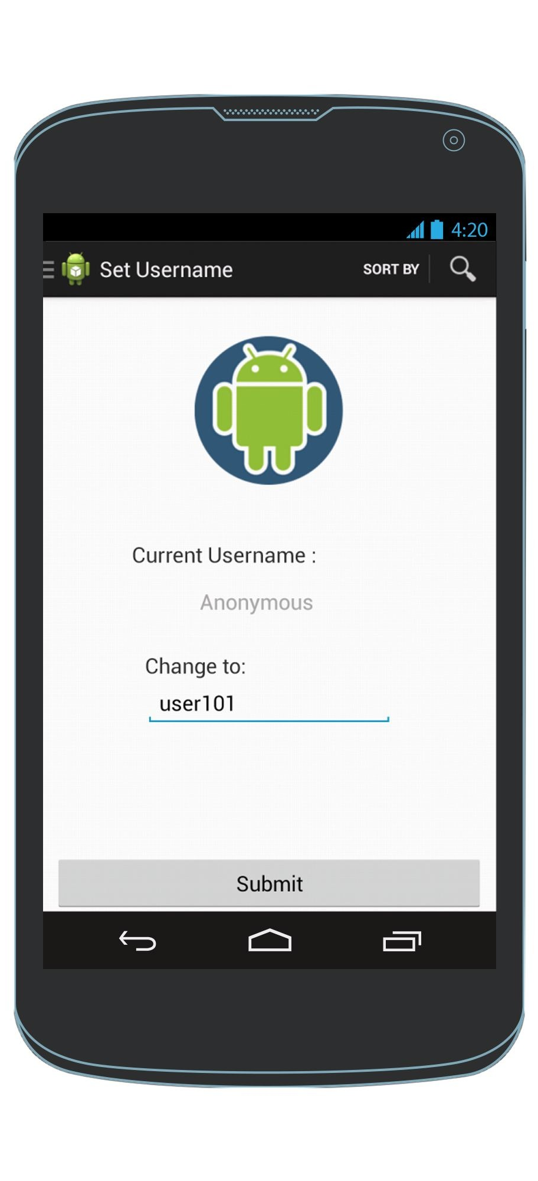
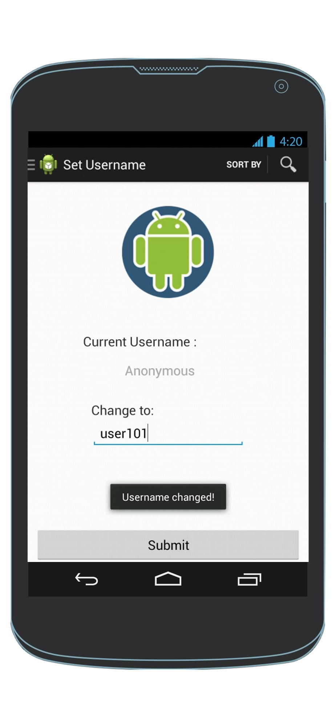
Set Username
Any Screen
Navigation Drawer
Enter username in box

Slide 12
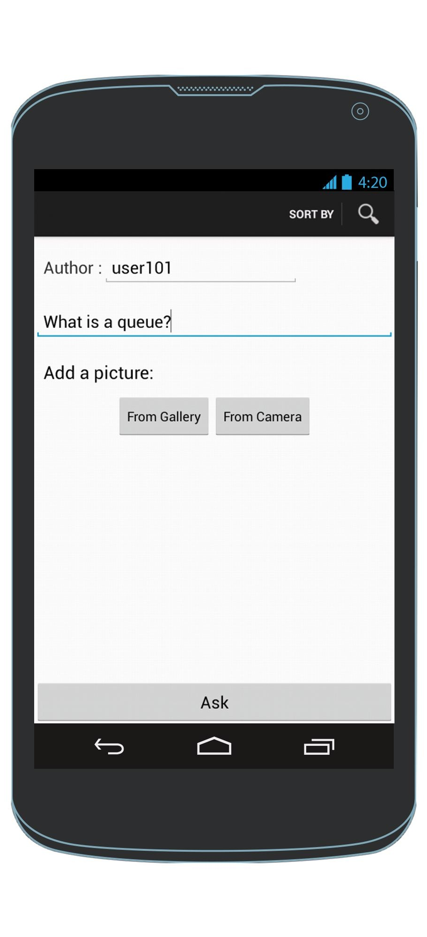
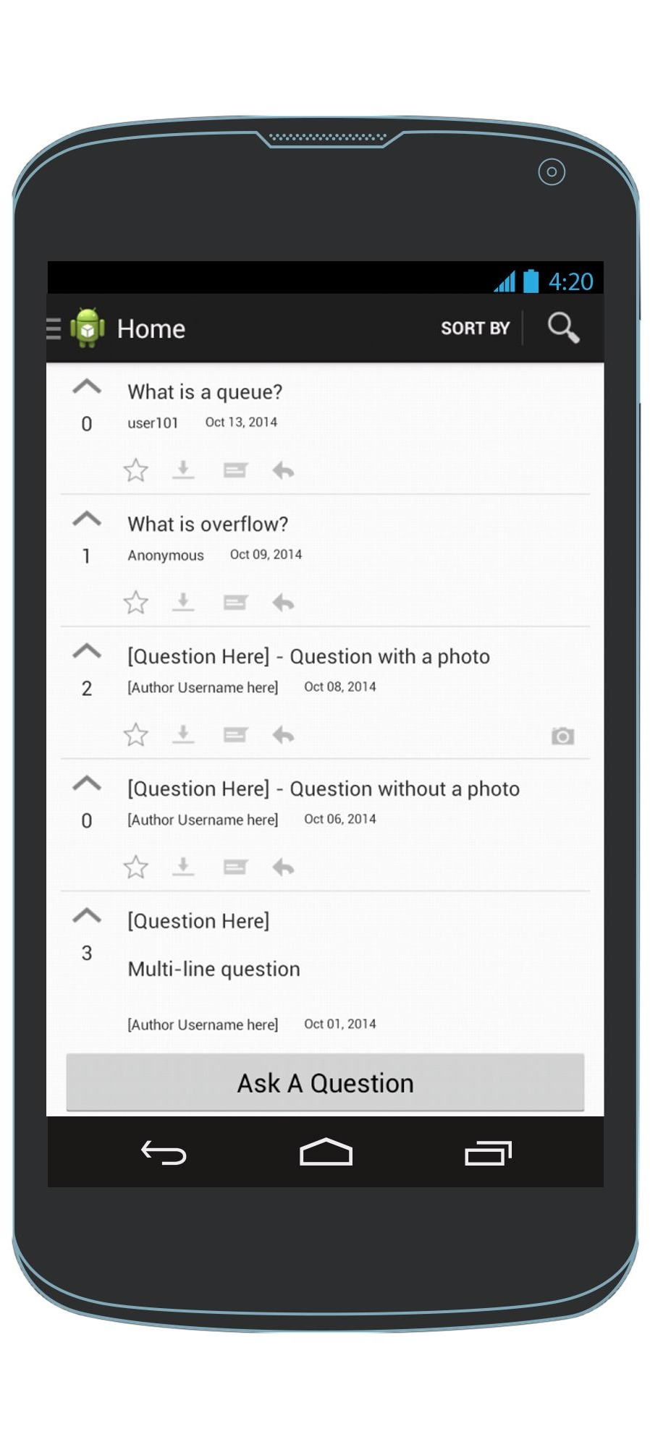
Ask a question
Questions are sorted by most recent by default
Enter a question
HomeScreen
AskAQuestionScreen
HomeScreen
Exception: To cancel & the AskAQuestion screen, click the back arrow

Slide 13

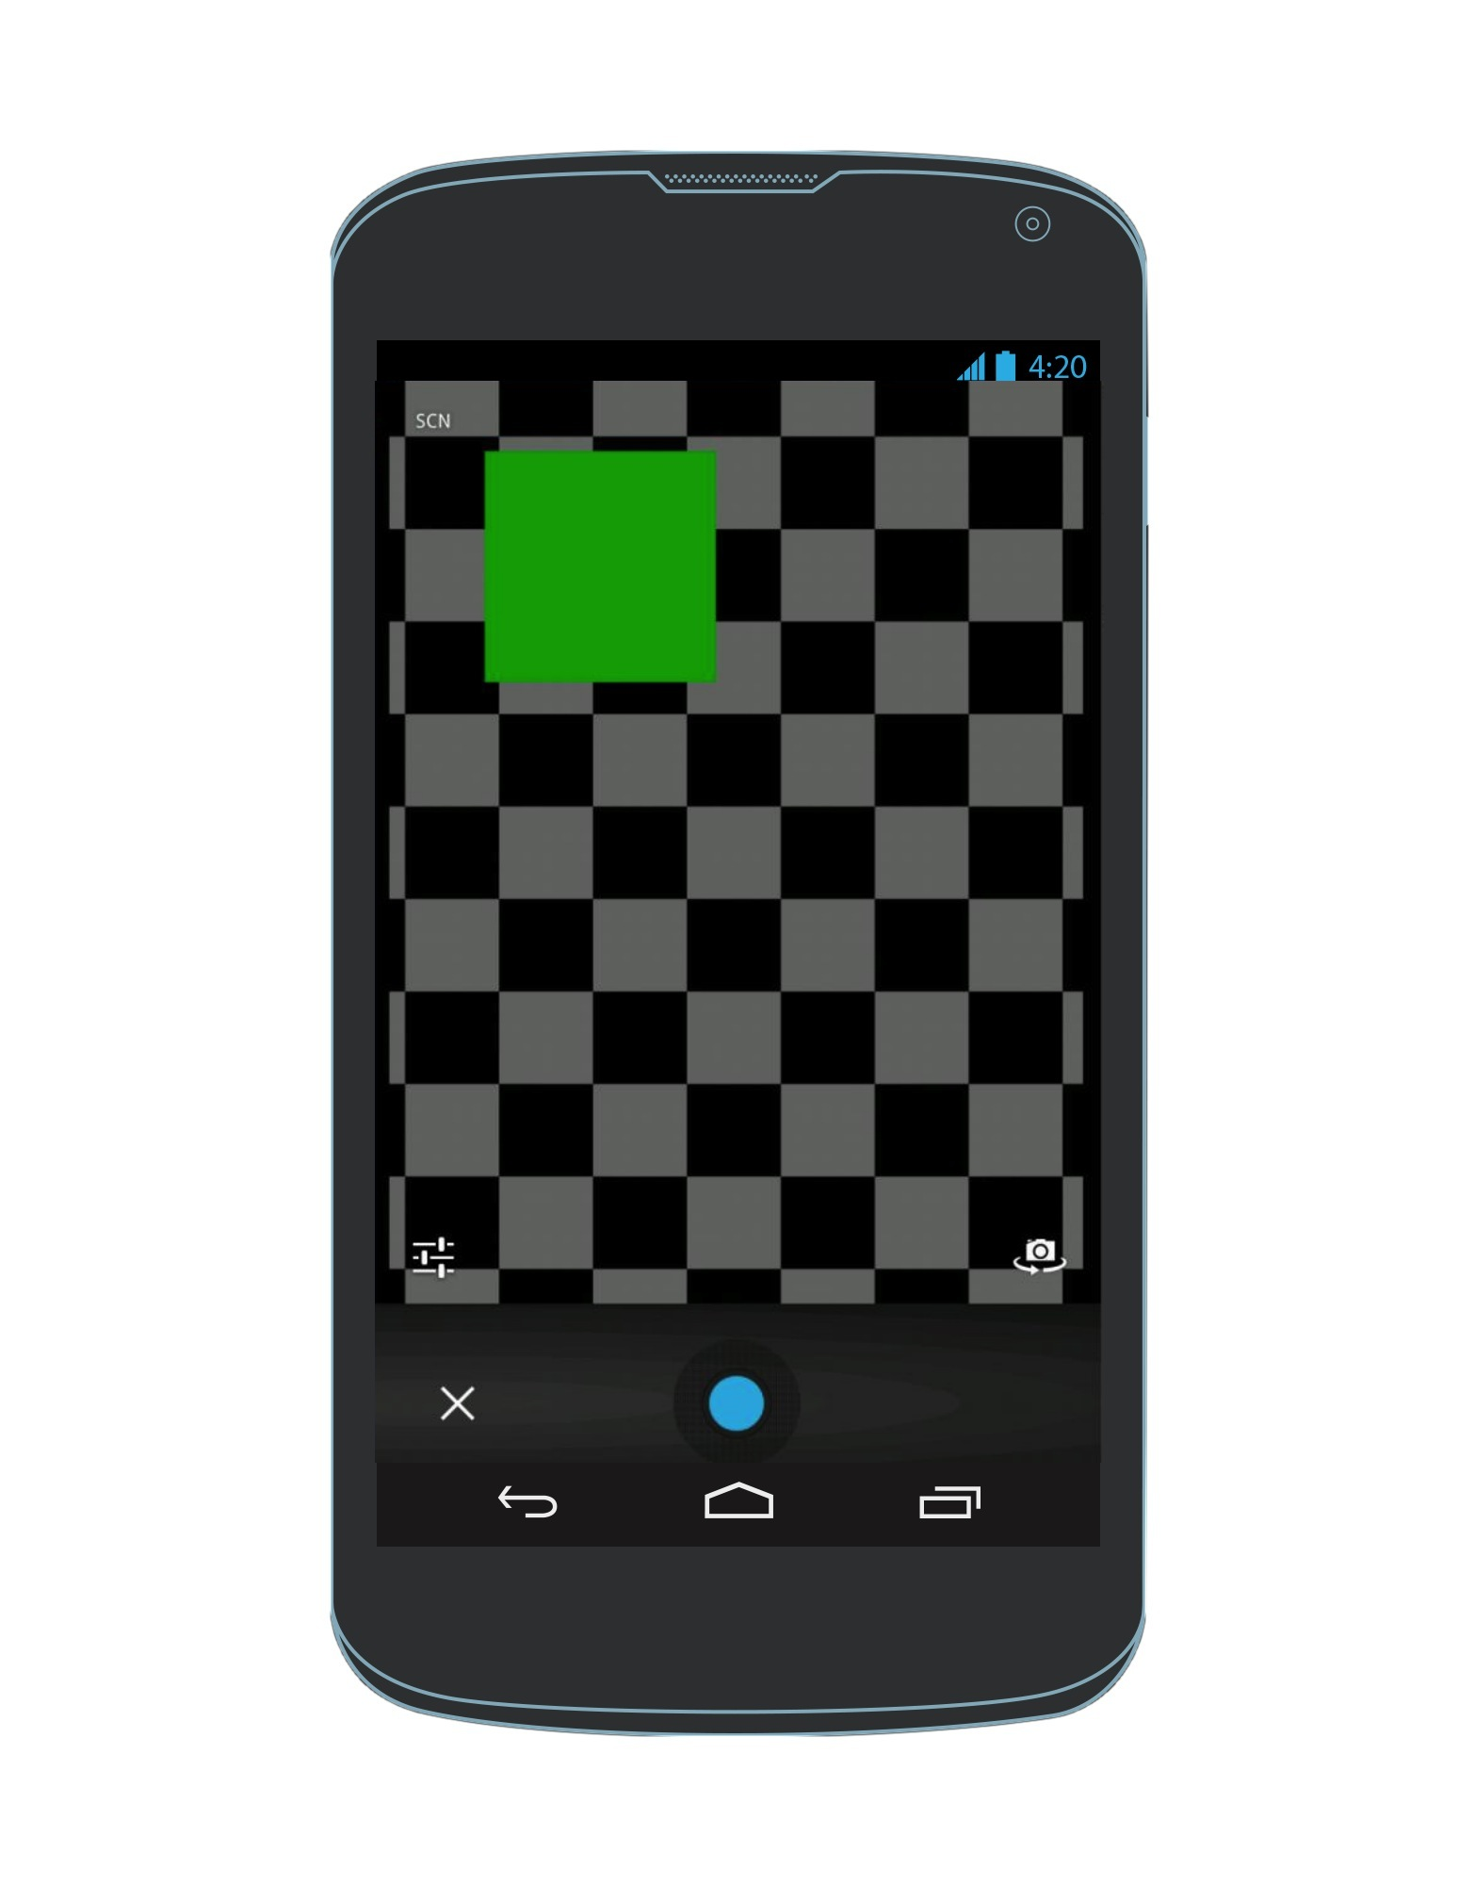
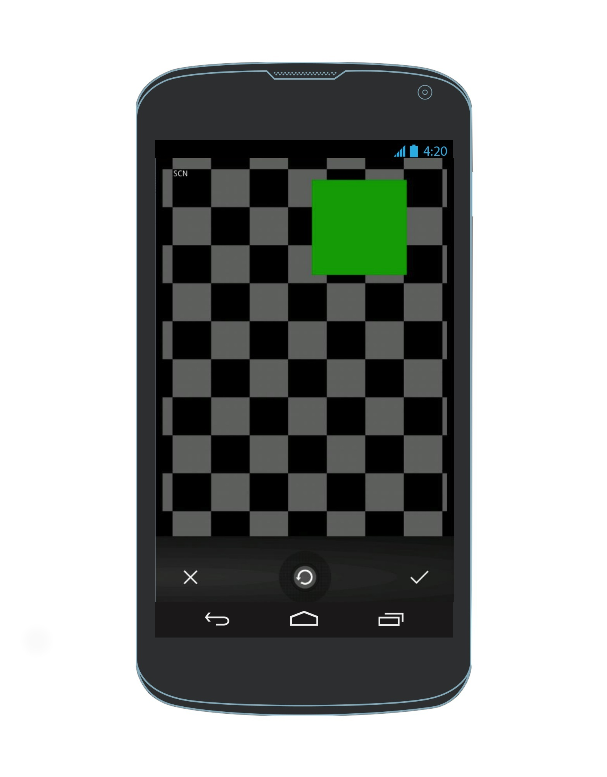
Alternative : Ask a question & attach a picture
Enter a question
Take a photo
Confirm you want to use this photo
HomeScreen
Attach a photo
Image Preview
AskAQuestionScreen

Slide 14
Exception : Photo is too large
Enter a question
Take a photo
Confirm you want to use this photo
HomeScreen
Attach a photo
Photo is large than 64 kb. Returns to AskAQuestionScreen
and lets user try again.
AskAQuestionScreen

Slide 15
See the questions I asked
The device remembers the questions asked by a specific user
Navigation Drawer
My Questions View

Slide 16
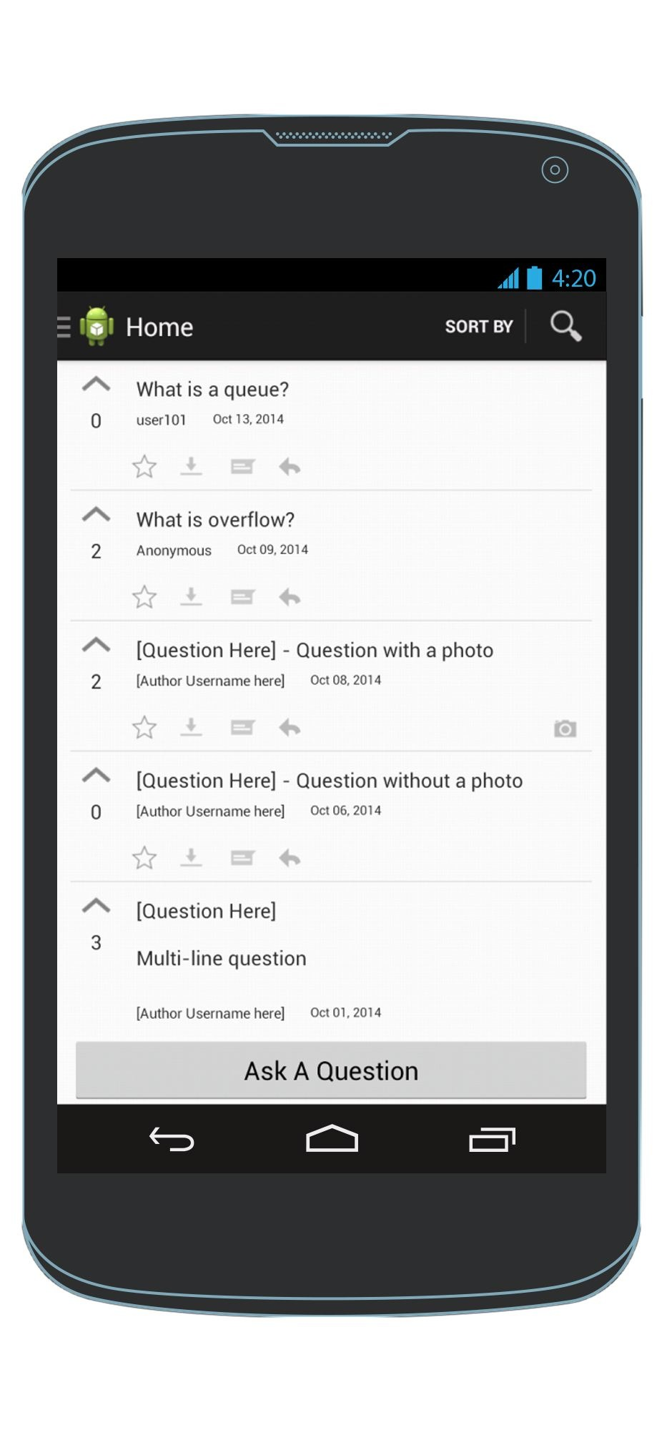
Upvote a question
HomeScreen
HomeScreen

Slide 17
View a question & its answers
Answers are sorted by most recent by default
HomeScreen
Q & A View

Slide 18
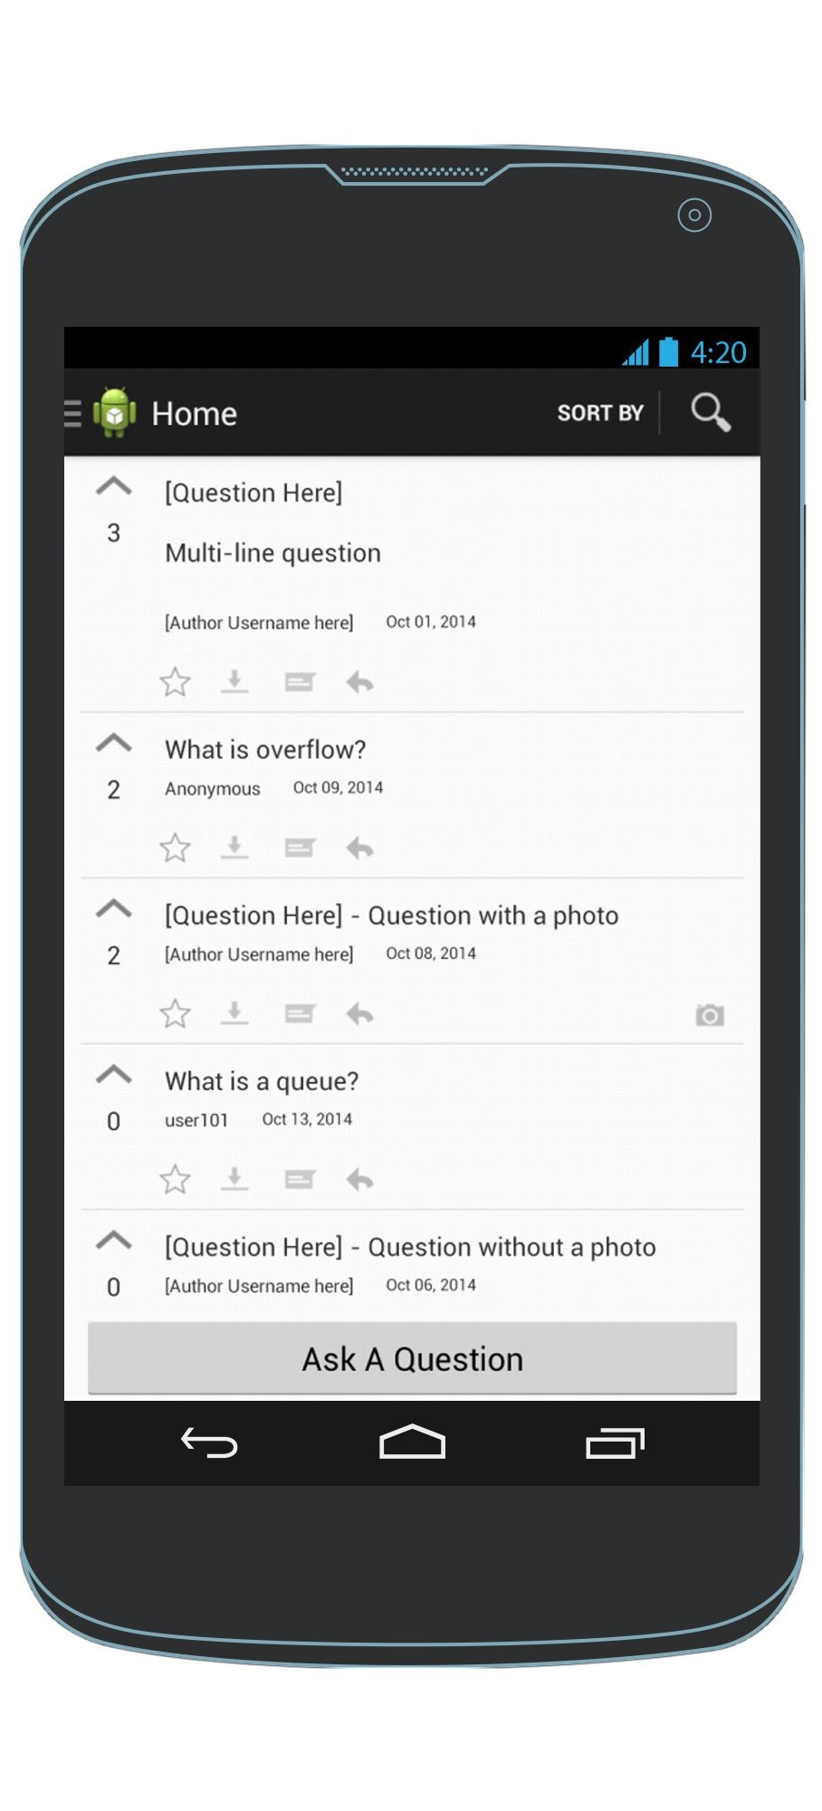
Sort questions by most upvoted (or least upvoted)
Questions are sorted by most upvoted
HomeScreen
HomeScreen
HomeScreen

Slide 19
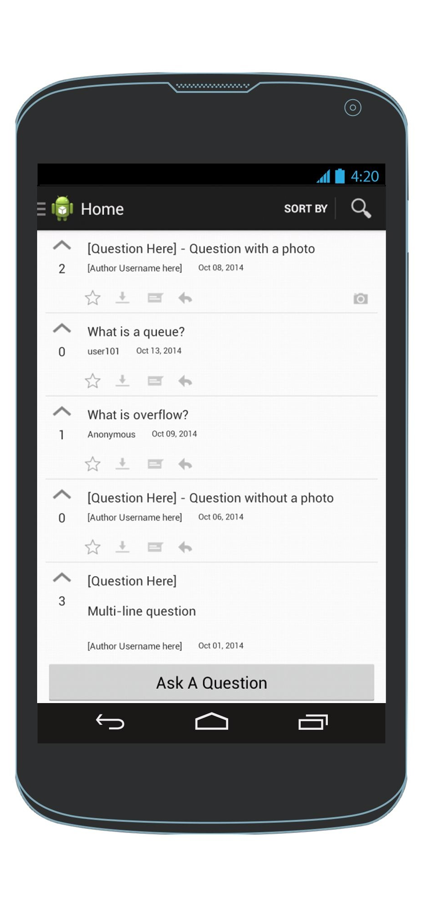
Sort questions by if they have(or don’t have) pictures
Questions with pictures are at the top
HomeScreen
HomeScreen
HomeScreen

Slide 20
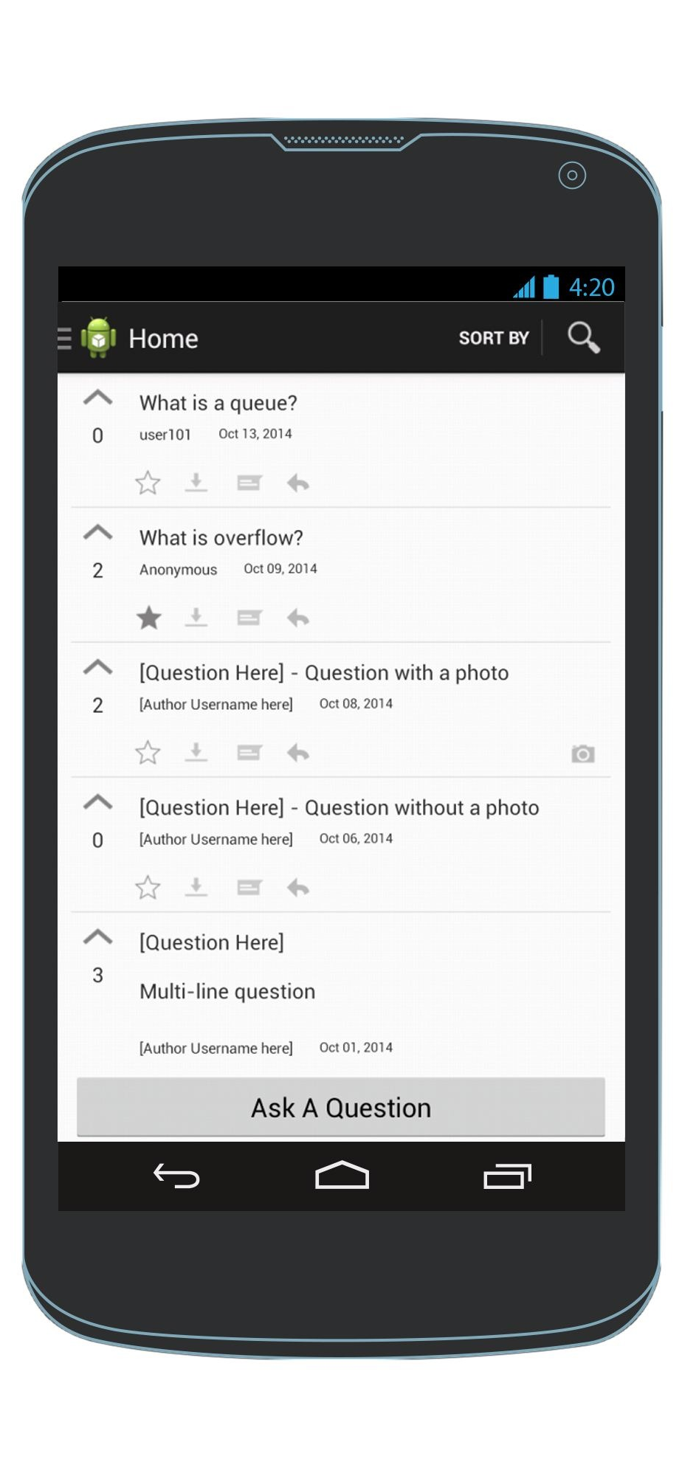
Save a question as a favorite
HomeScreen
HomeScreen

Slide 21
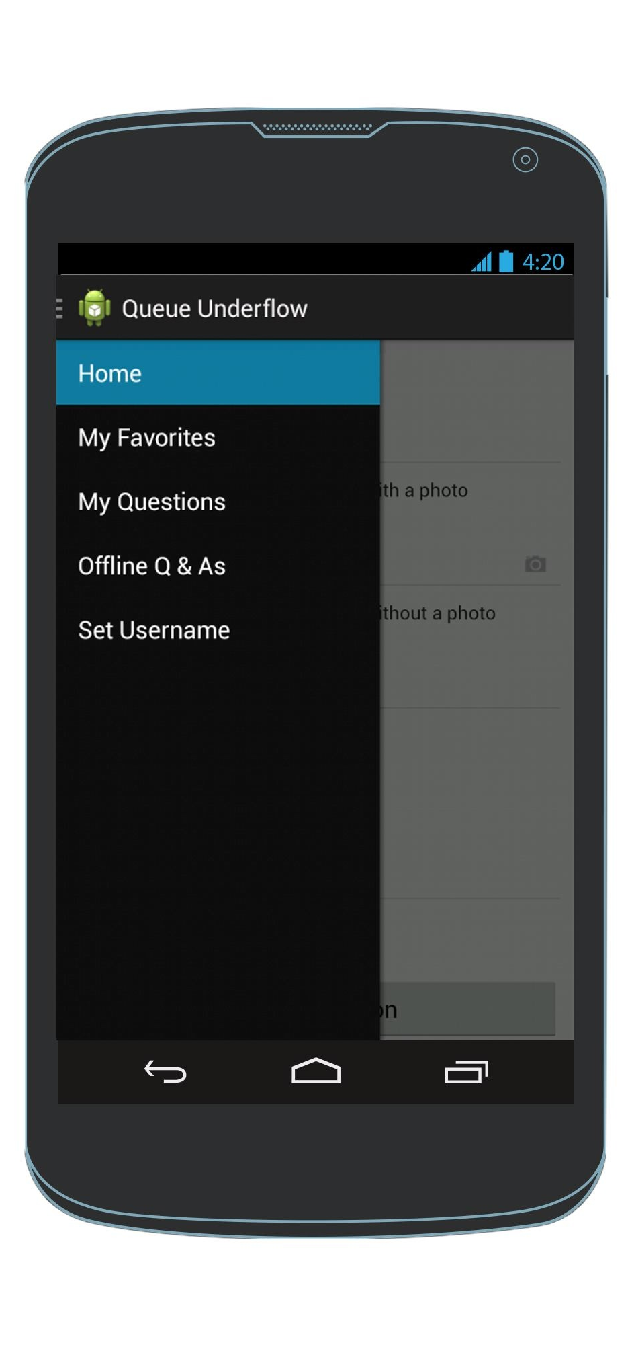
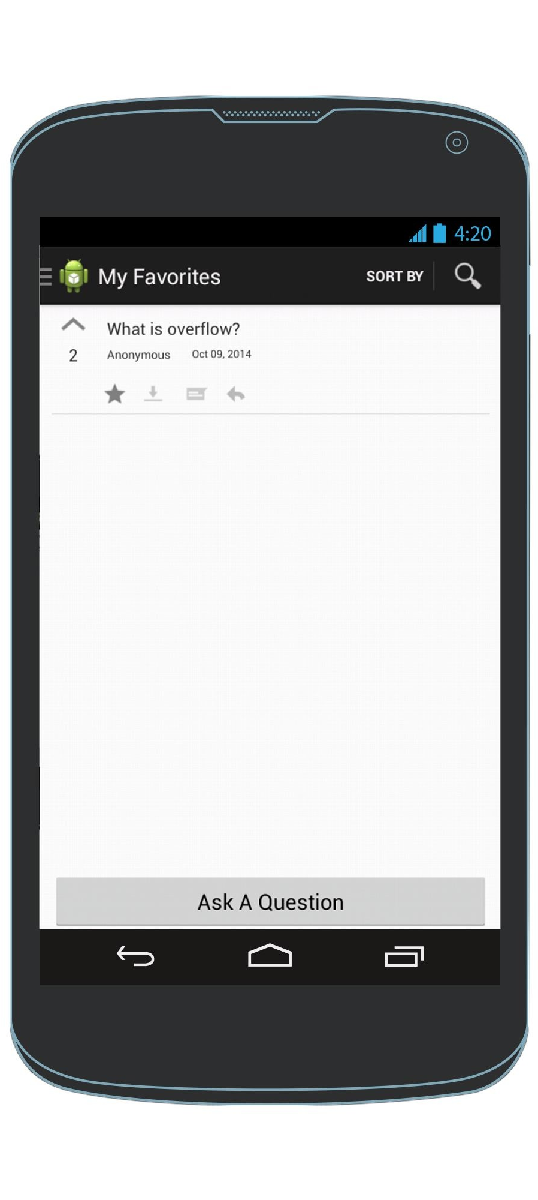
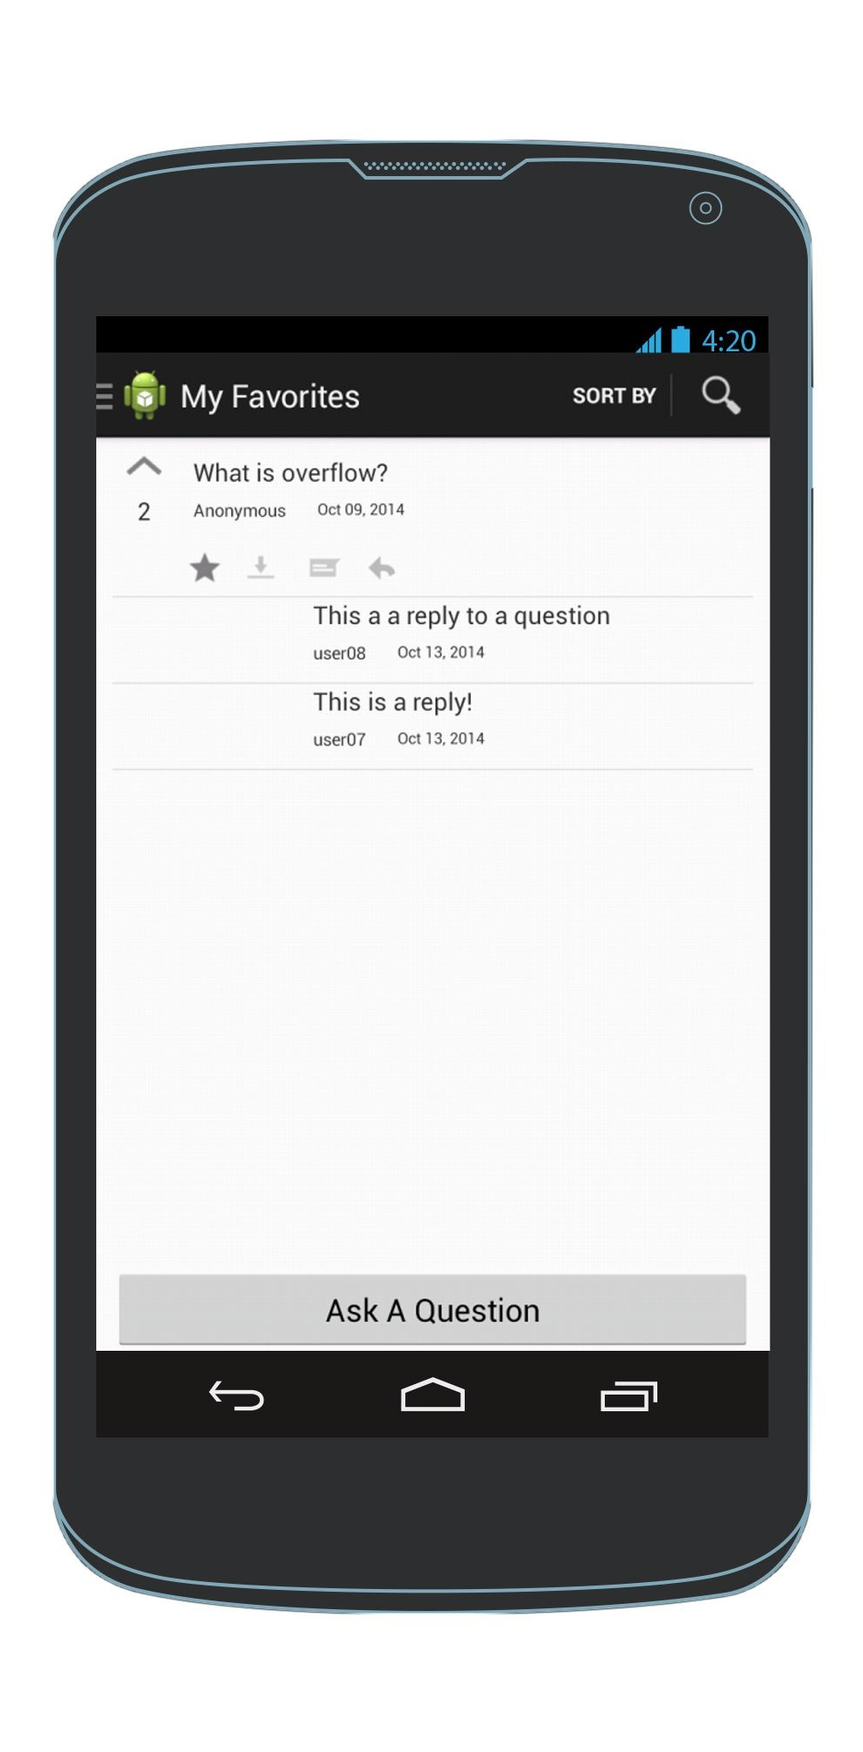
View questions that I’ve favorited and their replies
Available regardless of network connectivity.
Click again to remove from favourites
Navigation Drawer
My Favorites View
My Favorites View

Slide 22

Mark a question/answer for offline reading
HomeScreen
HomeScreen

Slide 23
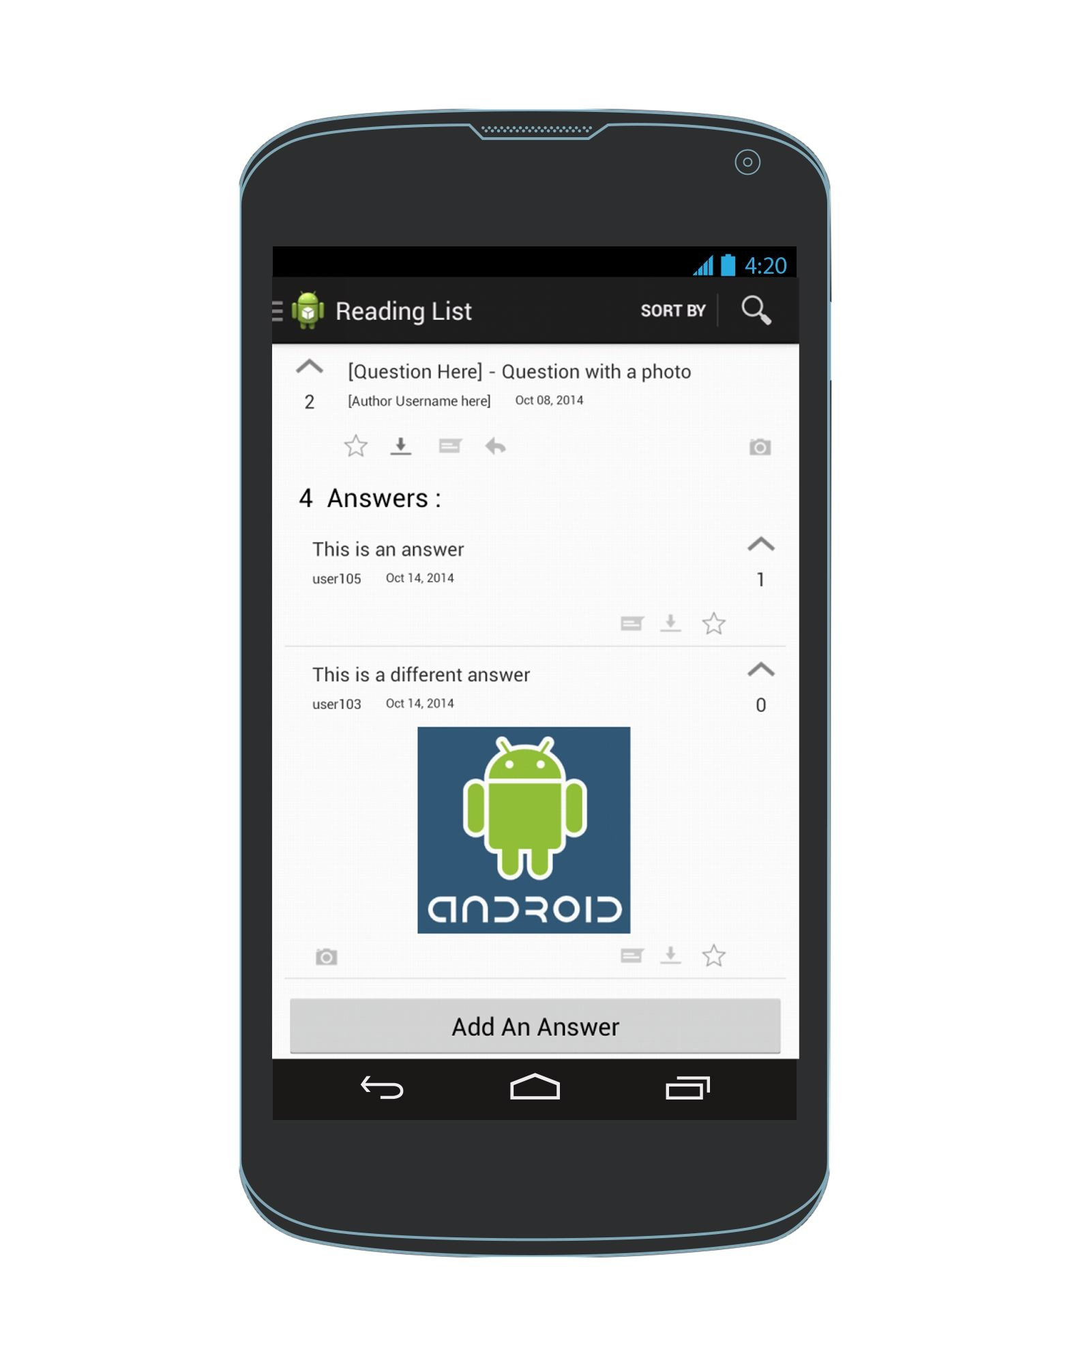
View questions & answers that I’ve indicated I want to read
Available regardless of network connectivity.
Offline Questions
Click again to remove from offline reading list
Navigation Drawer
Offline Q & As View
Offline Q & As View

Slide 24
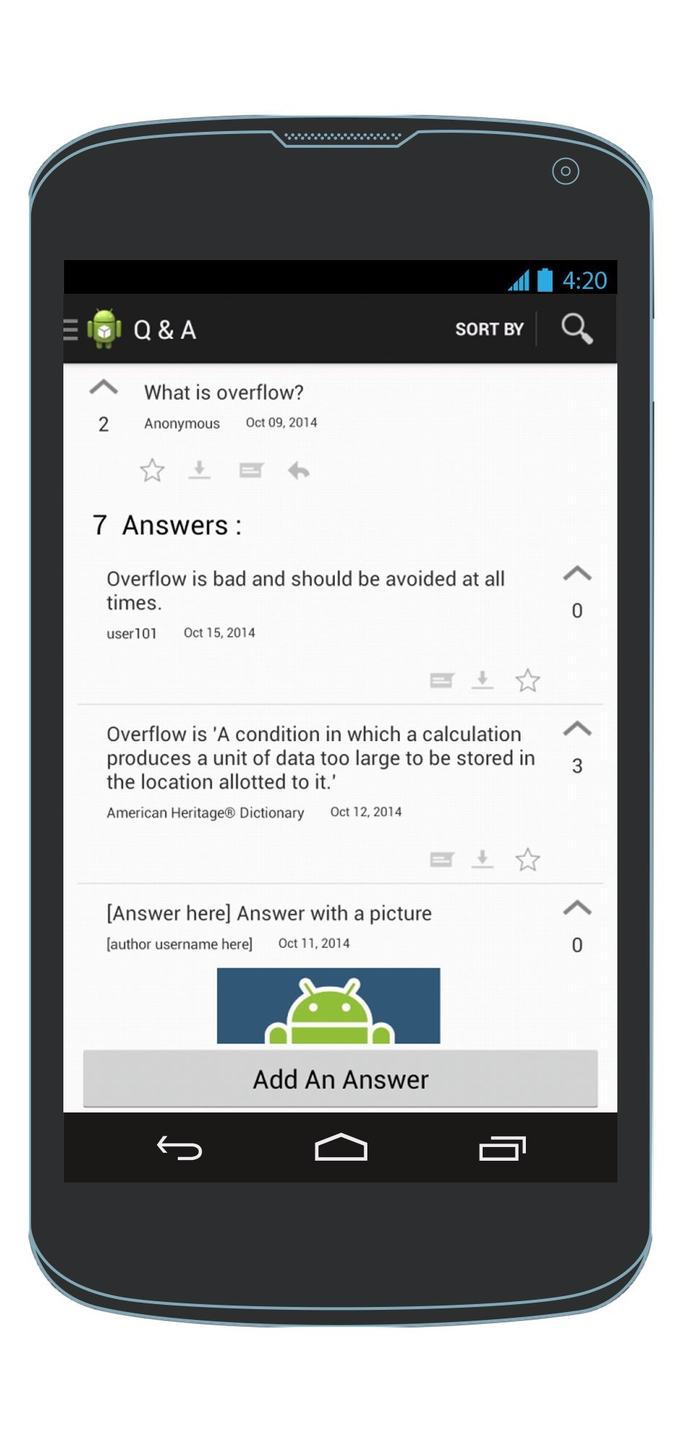
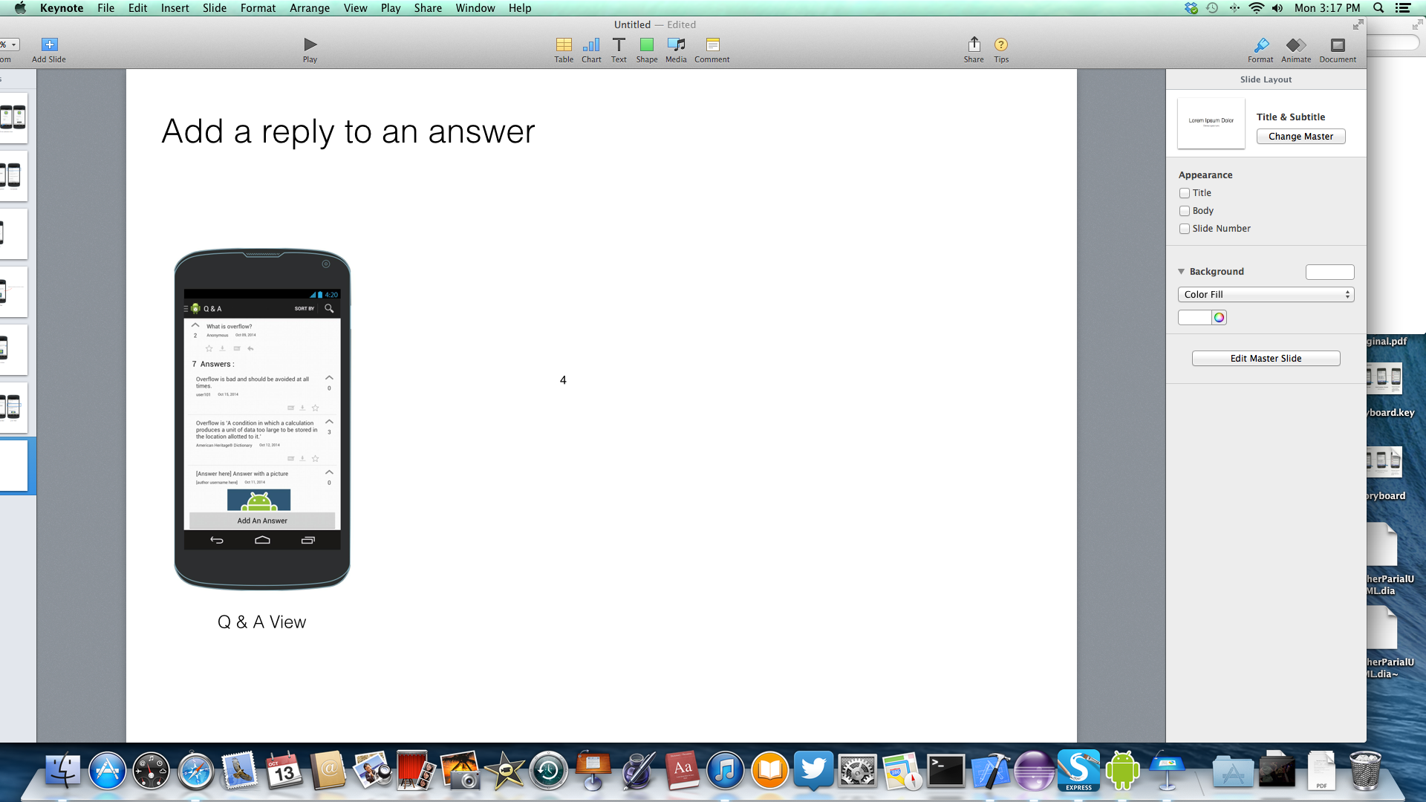
Sort answers by most upvoted (or least upvoted)
Answers are sorted by most upvoted
Q & A View
Q & A View
Q & A View

Slide 25
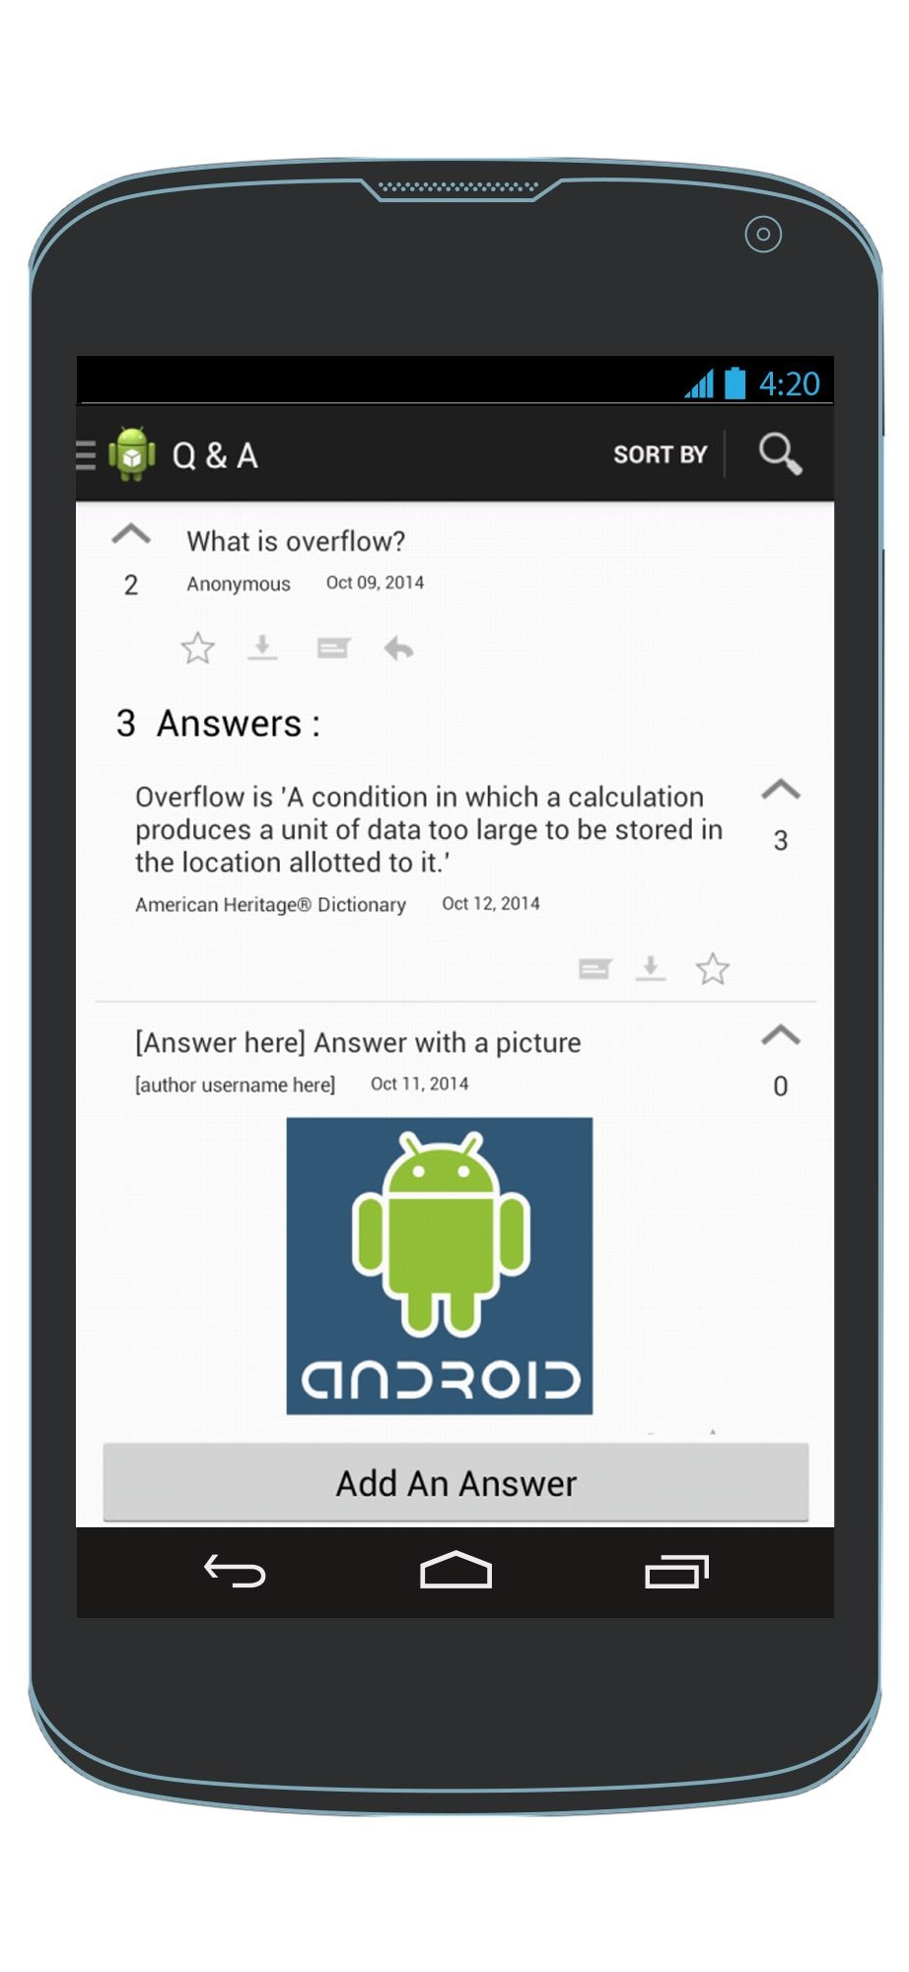
Upvote an answer
Q & A View
Q & A View

Slide 26
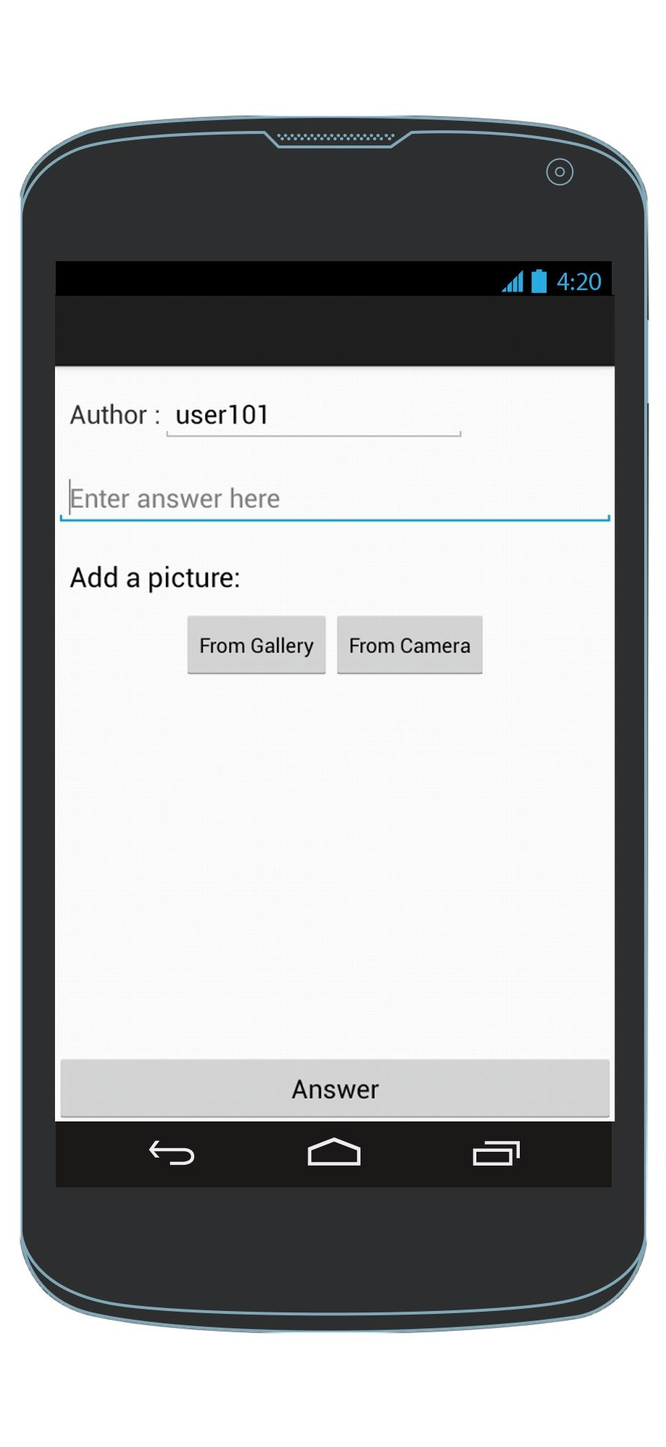
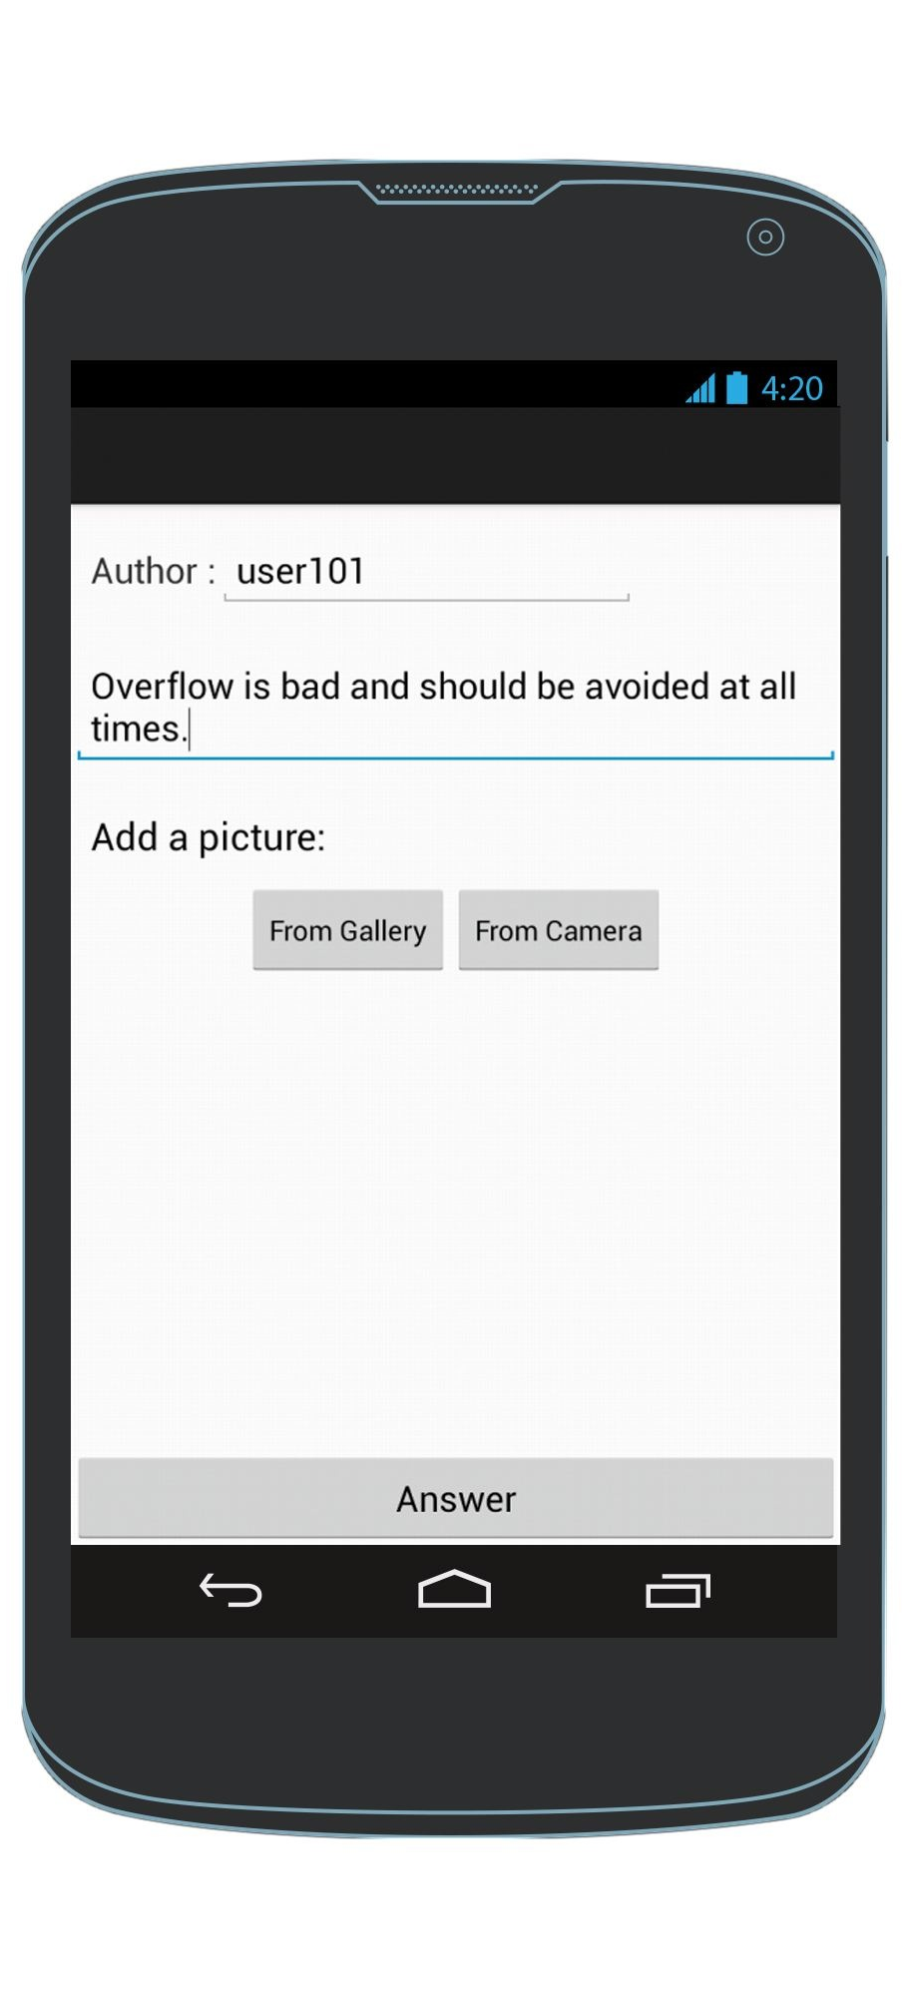

Add an answer
Enter an answer
Q & A View
AddAnAnswer Screen
Q & A View
Exception: To cancel & the AddAnAnswer screen, click the back arrow

Slide 27
View the replies of an answer
To see replies
To hide replies
Q & A View
Q & A View
Q & A View

Slide 28
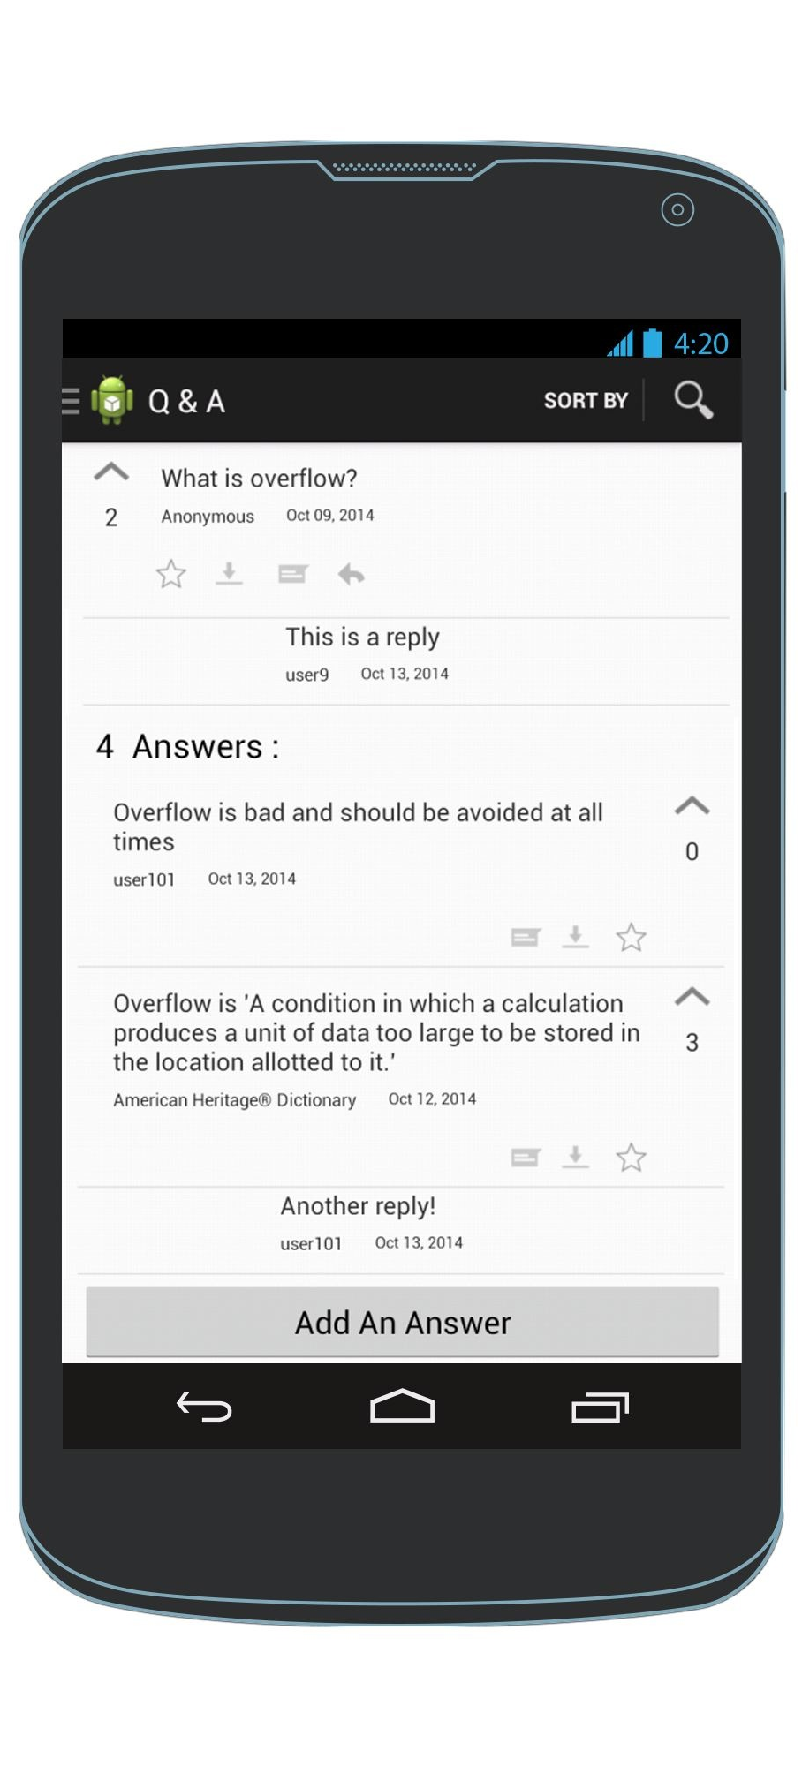
View the replies of a question
To see replies
To hide replies
Q & A View
Q & A View
Q & A View

Slide 29
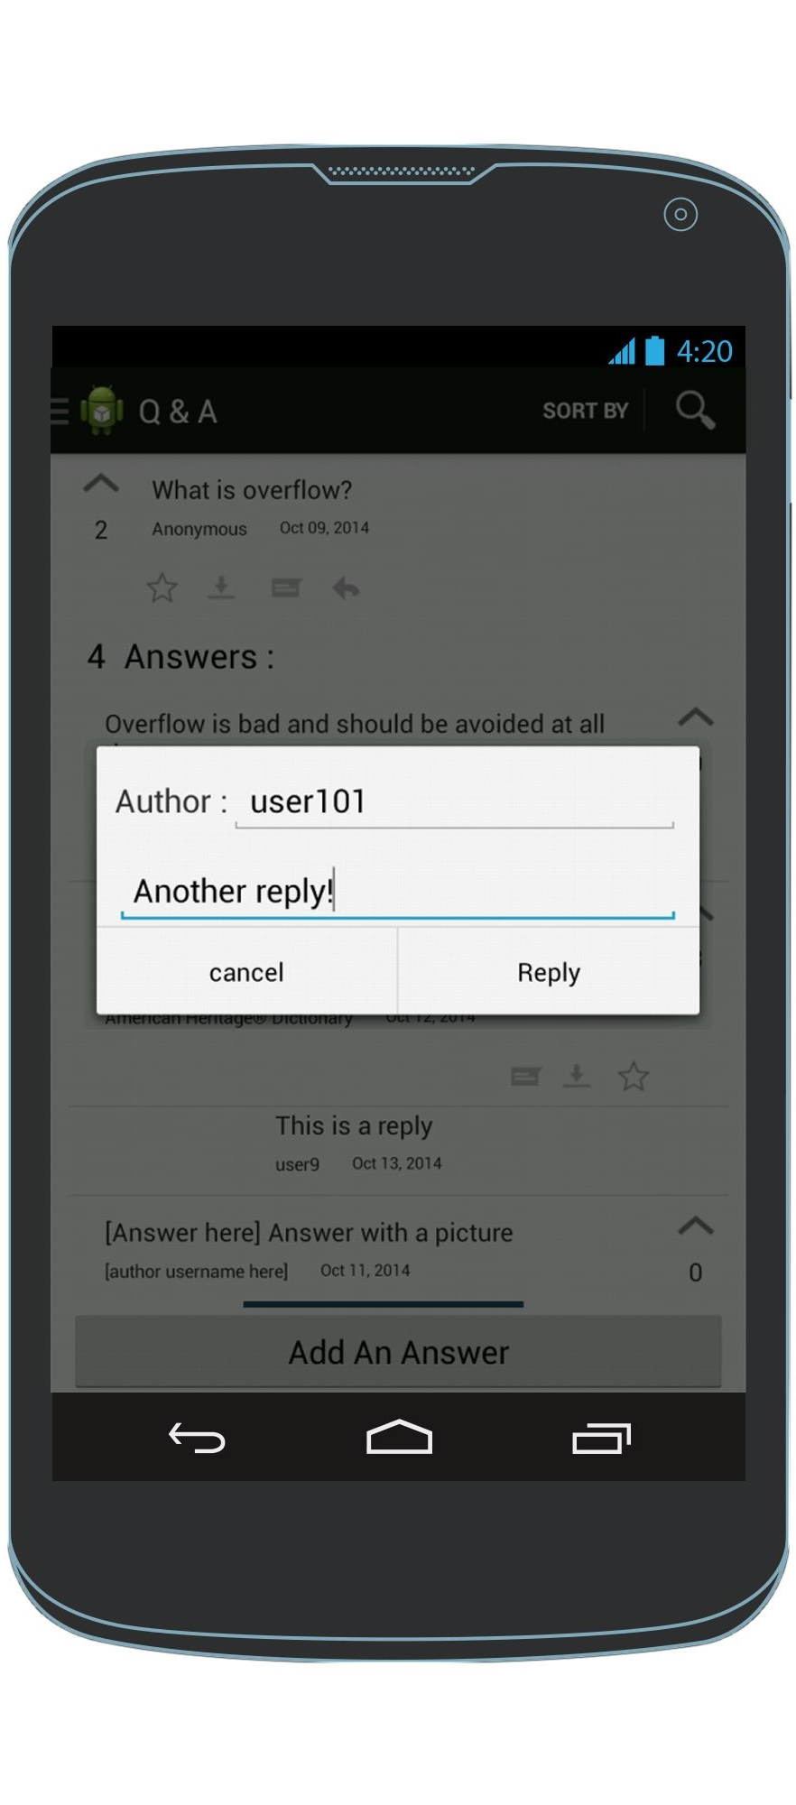
Add a reply to an answer
Enter a reply
Q & A View
AddAReply Screen
Q & A View

Slide 30
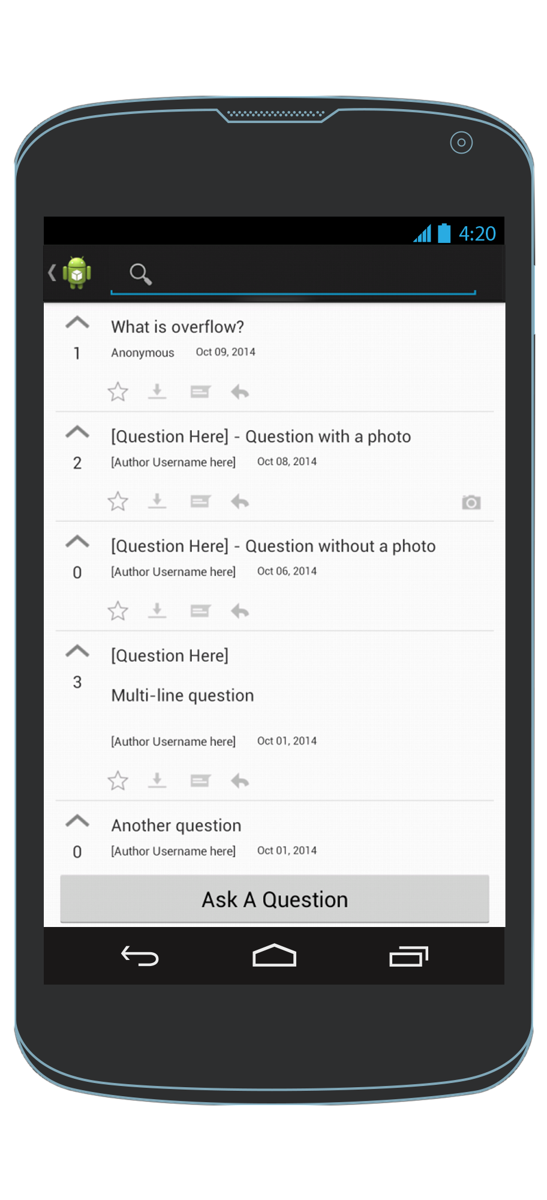
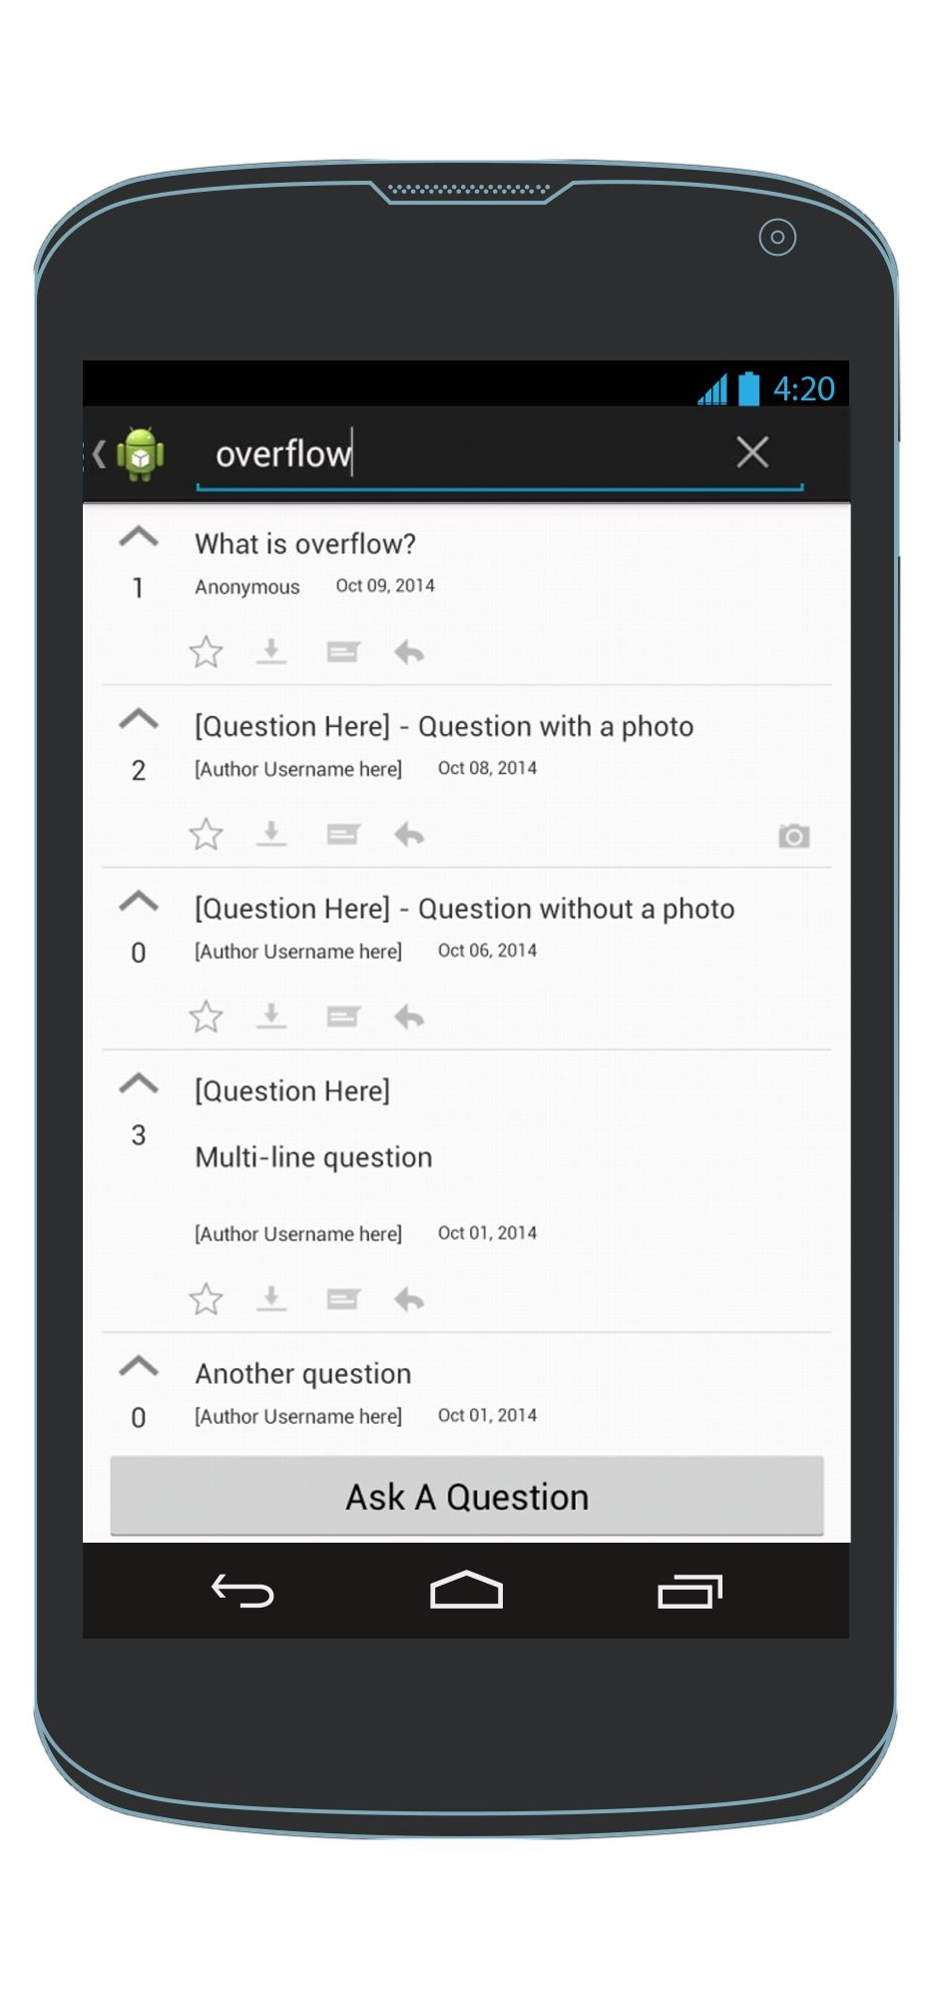
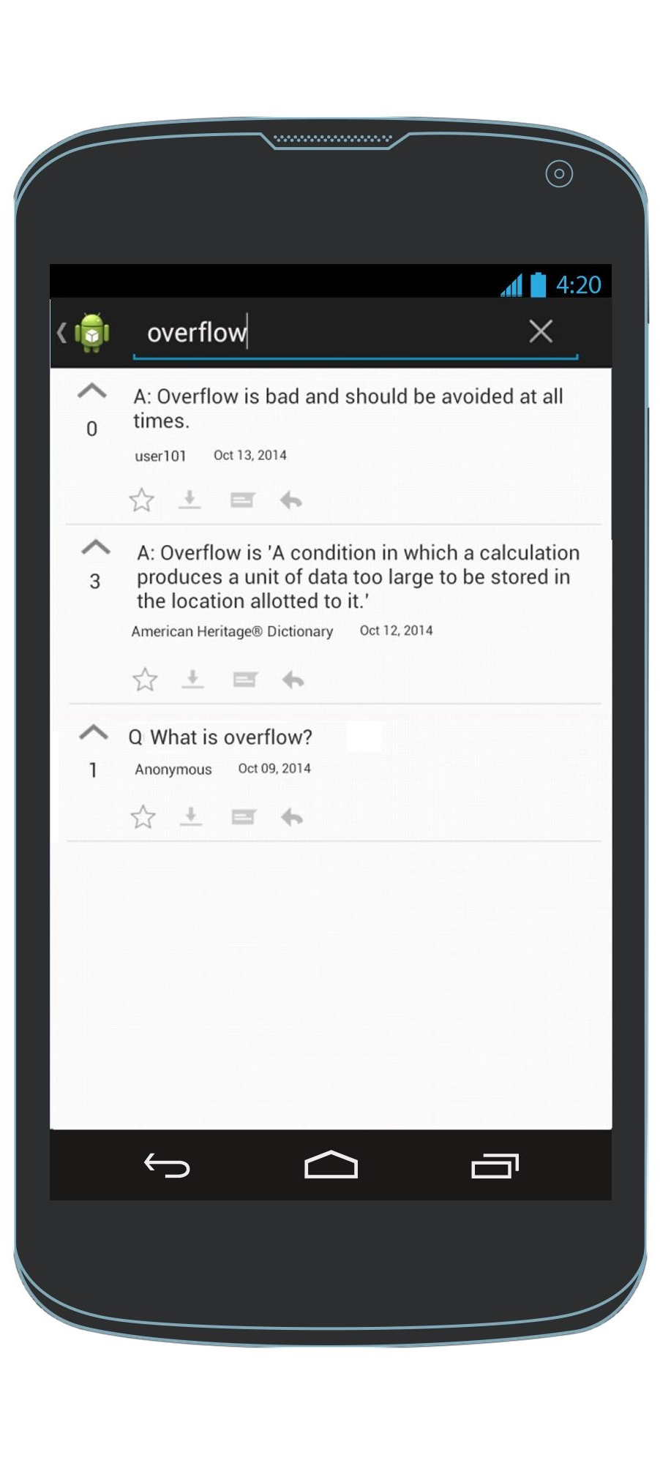

Search Option
When the user hits the return button on the keyboard, the search results screen appears
Enter search query in the search bar
Any Screen
SearchResults Screen

